Slide 1
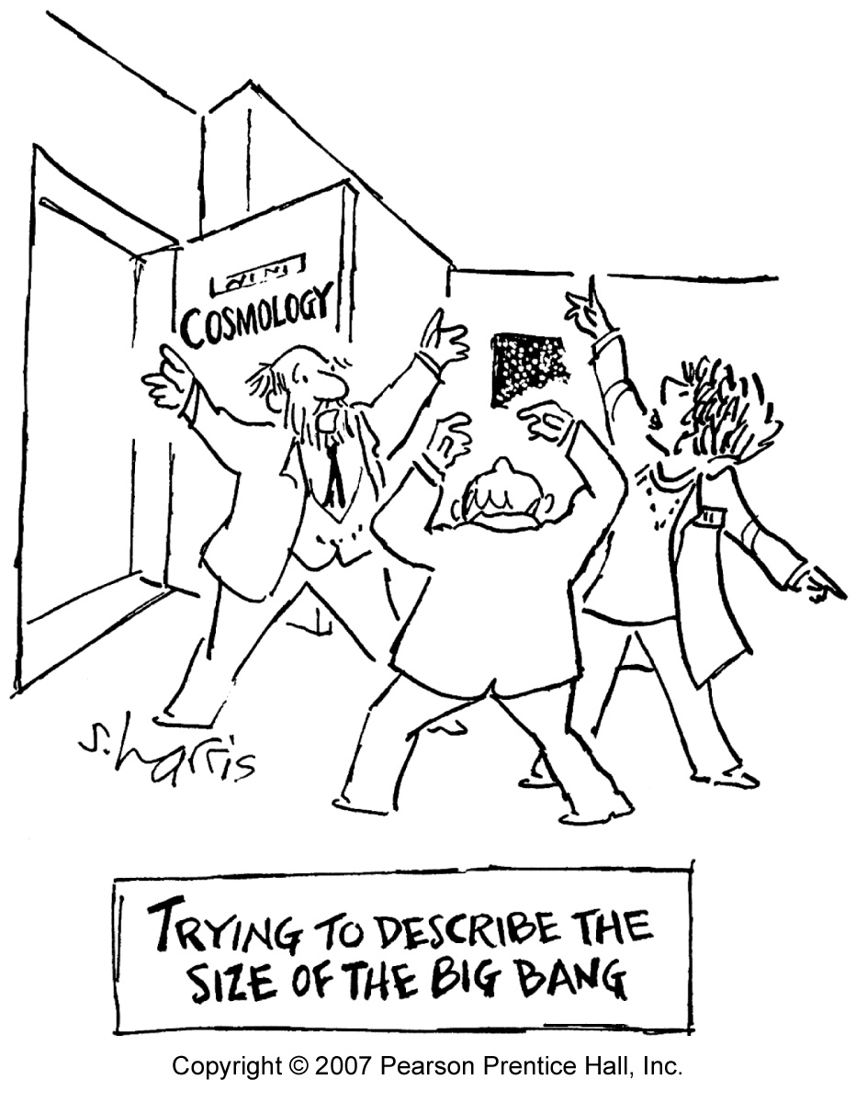
Teaching Controversial Topics in Physics Courses
Art Hobson
Univ of Arkansas
ahobson@uark.edu

Slide 2
Conceptual physics at U Arkansas
General physics, emphasizing modern physics, and societal topics.
The scientific process (we learn via evidence and reason) is a recurring theme.
Taught since 1975. Now ~1000 students/yr.
Many students (mostly women) report that they appreciate the social topics. Many others (mostly men) report that they appreciate the modern physics.
Many topics bear on controversial religious and political issues:

Slide 3
• pseudoscience
• --including creationism
• electric power plants
• growth, overpopulation
• 2nd law & evolution
• ozone depletion
• global warming
• radioactive dating
• geological ages
• biol effects of radiation
•nuclear weapons
• nuclear terrorism
• the energy future
• nuclear power
• fossil fuels
• renewable energy
• energy efficiency
• age of universe & Earth
• the big bang
• THE SCIENTIFIC PROCESS

Slide 4
You’ll find discussions of all these topics in my textbook, available at the Pearson booth at this meeting.

Slide 5
A clear scientific consensus exists on nearly all of these. In this case:
Present the scientific consensus, being careful to explain how we know (i.e. the evidence).
Emphasize: science is based on evidence and reason, not tradition, authority, politics, or feelings.
Encourage students to express their doubts. If there is a scientific consensus concerning these particular doubts, present it (diplomatically): “Thanks! It’s a good point. In fact, scientists have considered this point, and ……..”

Slide 6
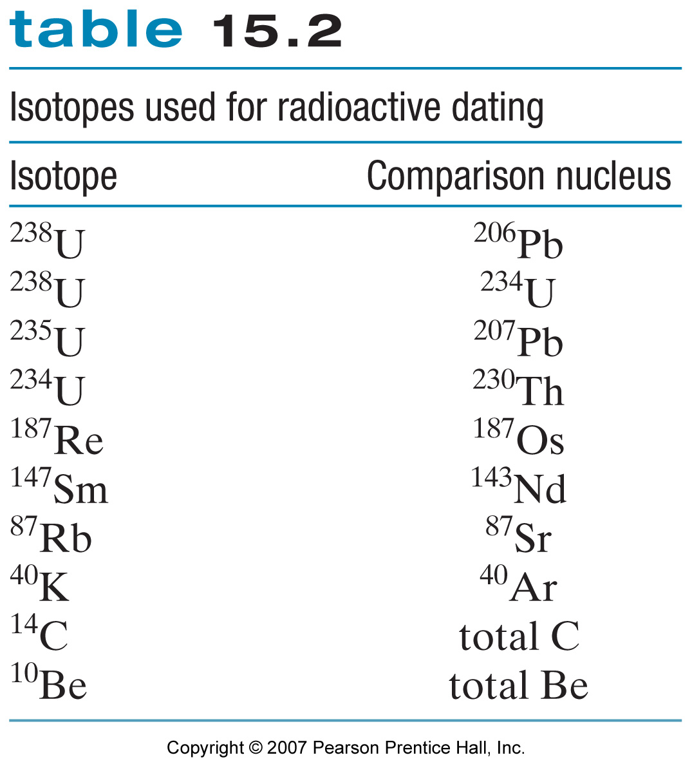
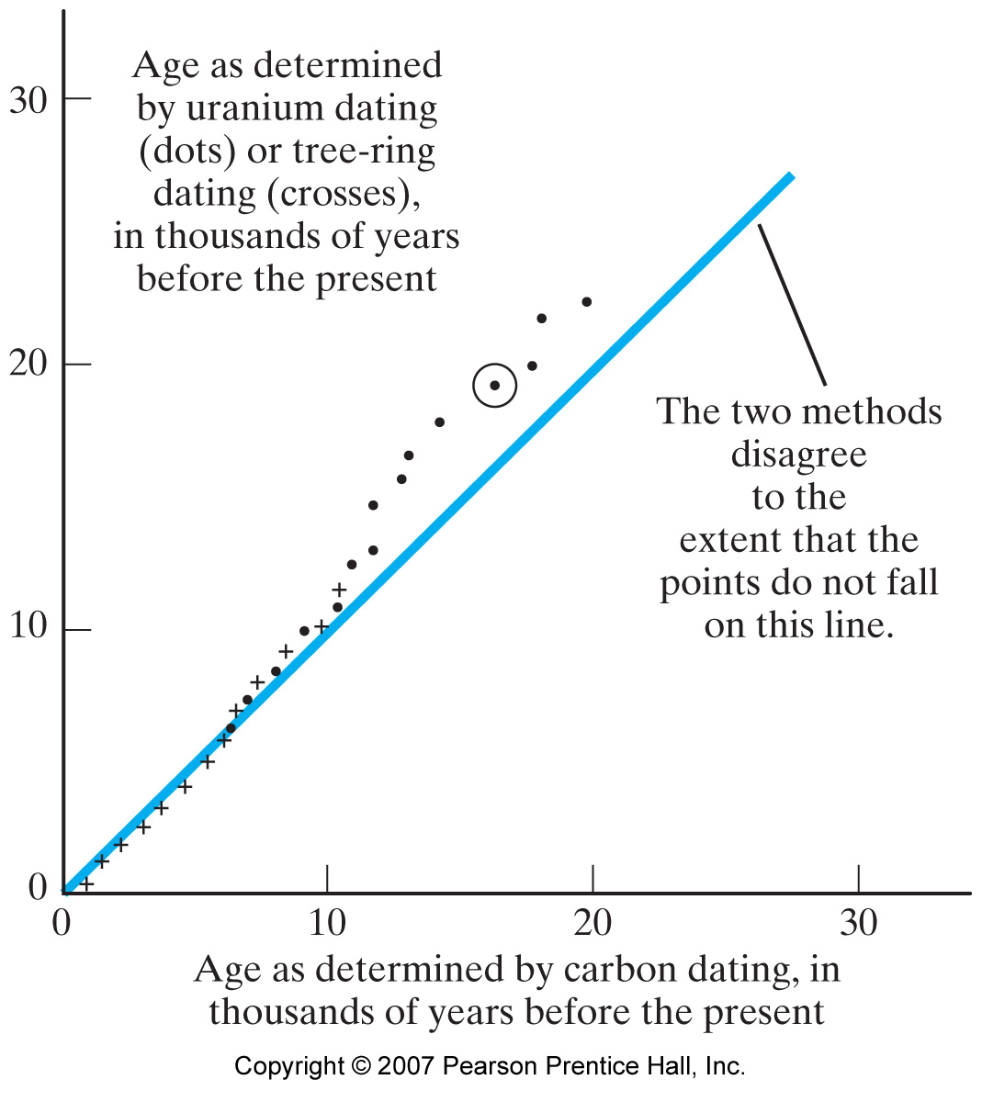
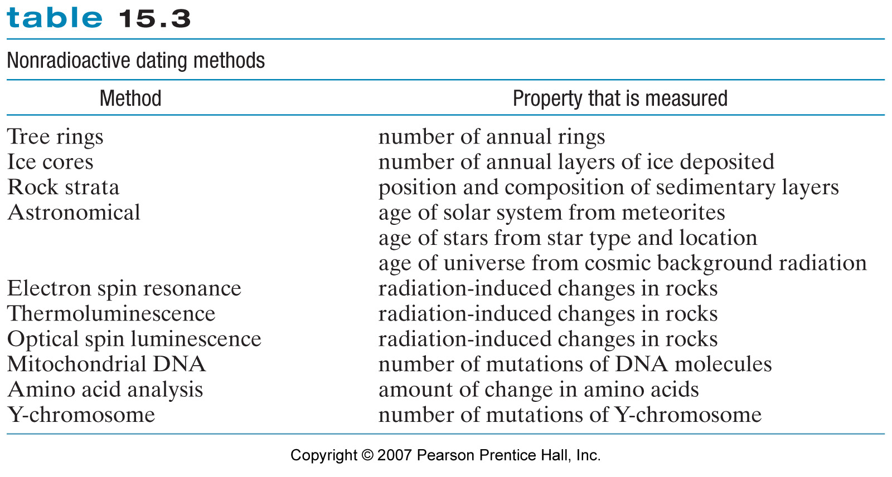
EXAMPLE: radioactive dating, Earth’s age, geological ages. Evidence:

Slide 7
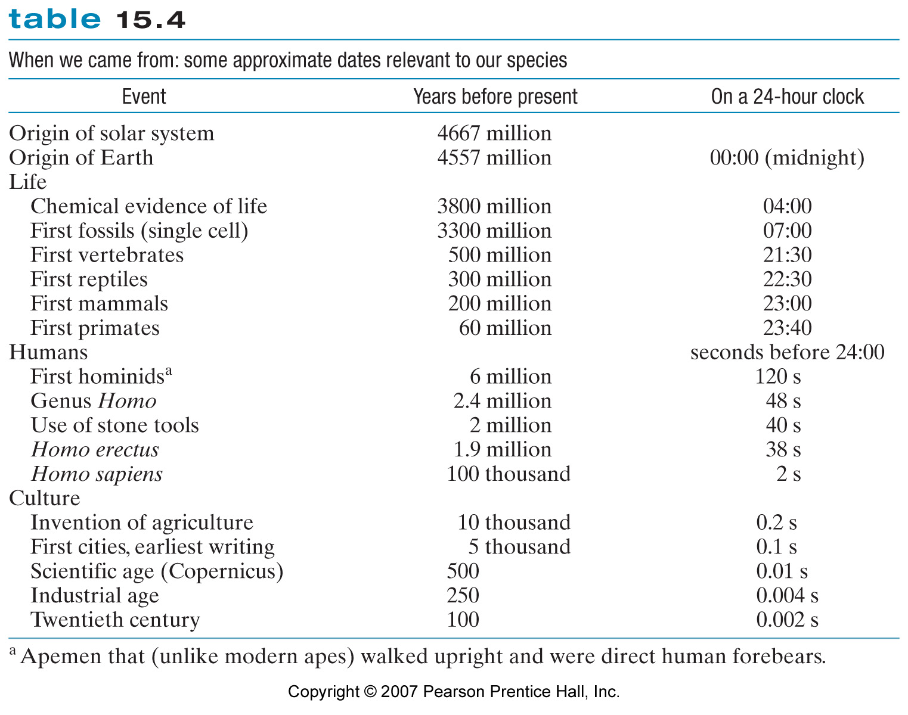
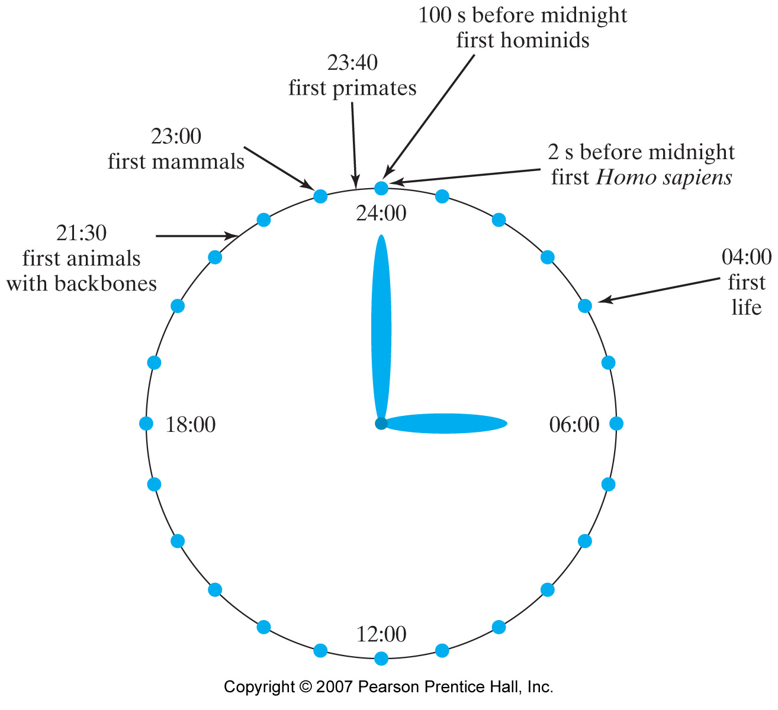
Some conclusions based on this evidence:

Slide 8
If a clear sci consensus does not exist (nuclear power? overpopulation?):
Either present the sci evidence on both sides, or simply say that no sci consensus exists.
This might be a good opportunity for a class debate/discussion!

Slide 9
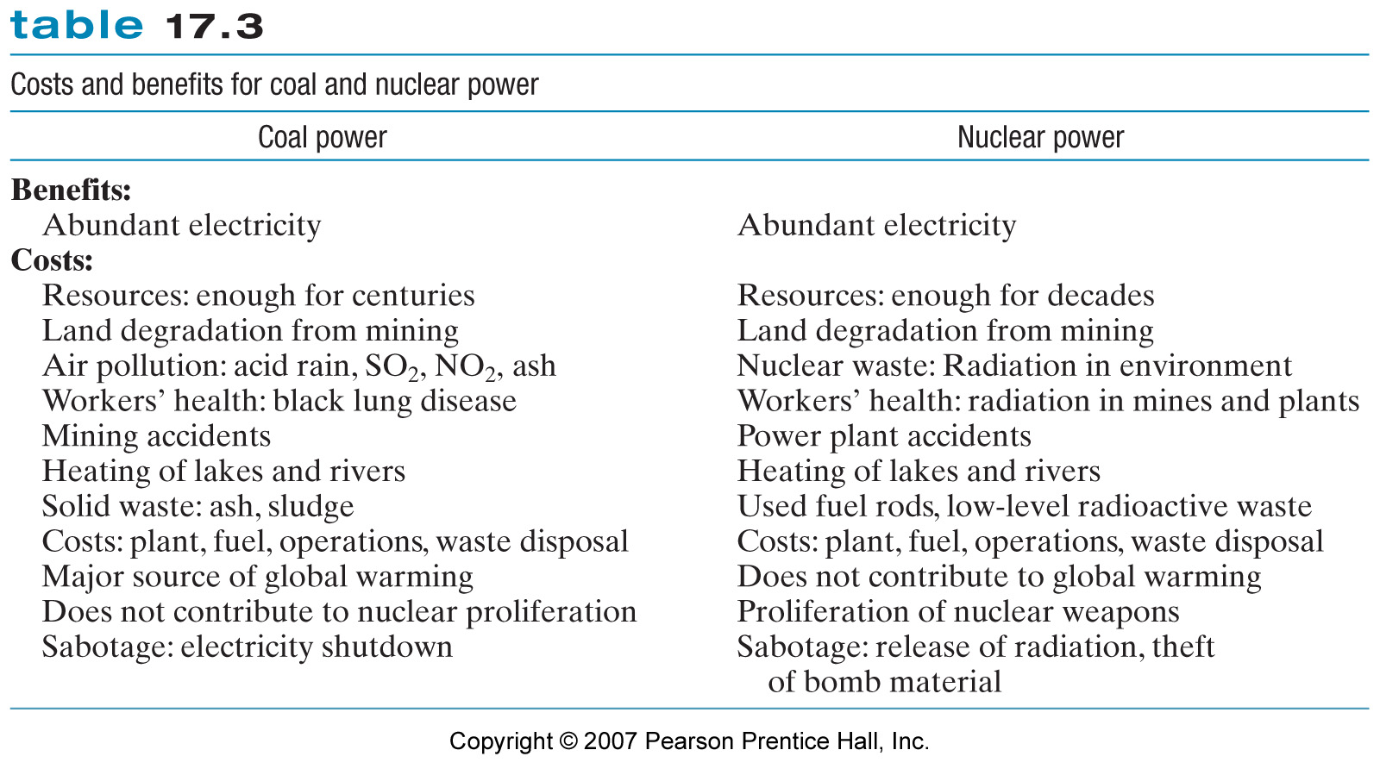
EXAMPLE: Nuclear power
Coal is one widely-used “competitor” to nuclear. Students can “brainstorm” costs & benefits of both.
A few:

Slide 10
THANKS!

