Slide 1
Review and suggested resolution of the problem of Schrodinger’s cat
Art Hobson
U Arkansas
Colloquium, 2 Feb 2017
• Published in Contemporary Physics, Nov. 2017
• Posted on arXiv

Slide 2
OUTLINE
1. Review of quantum measurement problem.
2. Suggested resolution, based on nonlocality.
3. How to fix things so the “cat” misconception doesn’t arise.

Slide 3
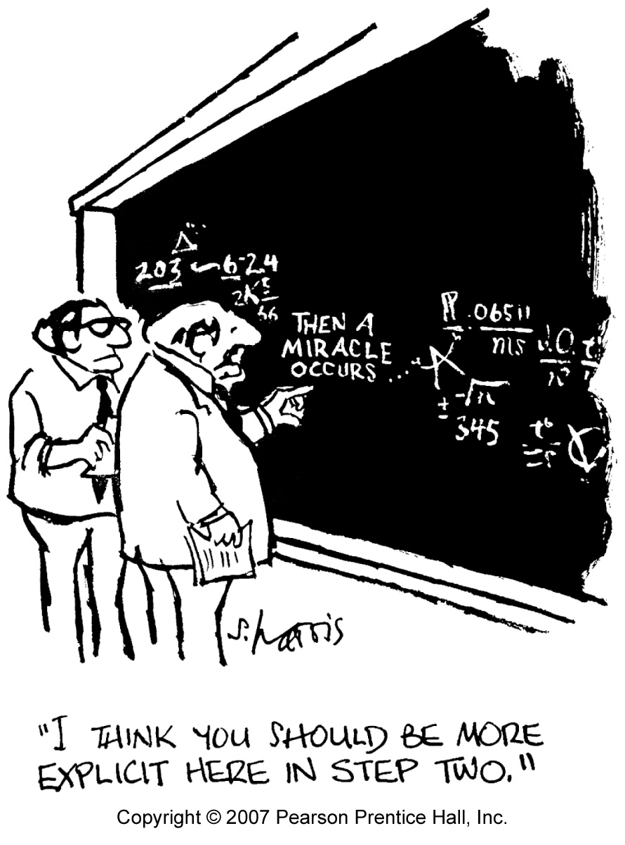
1. The measurement problem
• The problem of collapse of the wave function:
• Do superpositions collapse upon measurement?
• If so, how and why do they collapse?

Slide 4
• Einstein’s remark, 1927 Solvay Conference:
• Collapse occurs. (Right)
• It is non-local. (Right)
• This violates SR. (Wrong)

Slide 5
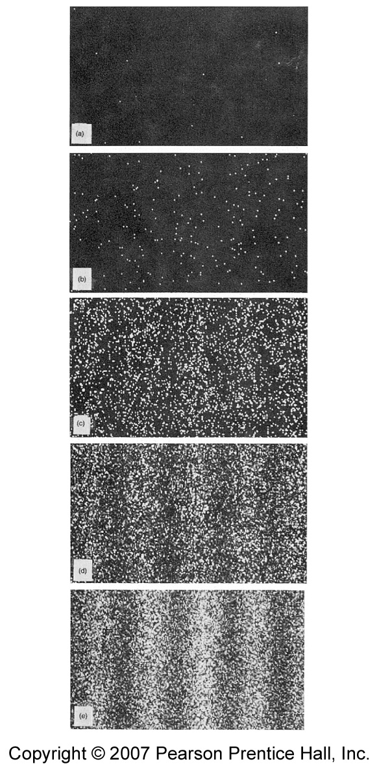
Useful example: 2-slit exp with electrons, with & without a “which-slit” detector
1
2
Interference pattern emerges from individual electron impacts in this famous experiment by Tonomura et al, 1989.
The “detector effect.”

Slide 6
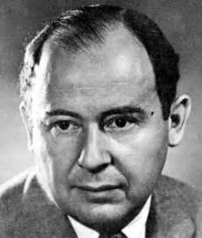
John von Neumann’s analysis, in 1932, applied to a which-slit measurement:
|ψ₁>, |ψ₂> : electron on path 1, 2
|ready>, |1>, |2> : states of detector
“Ideal vN measurement” is one for which
|ψ₁>|ready> è |ψ₁>|1>
|ψ₂>|ready> è |ψ₂>|2>.
From the linearity of quantum physics:
The superposition |ψ₁> + |ψ₂>)/√2
evolves this way:
(|ψ₁> + |ψ₂>)/√2 |ready> è (|ψ₁>|1> + |ψ₂>|2>)/√2 = |Ψ>_{M}
This “measurement state” is entangled.
1932

Slide 7
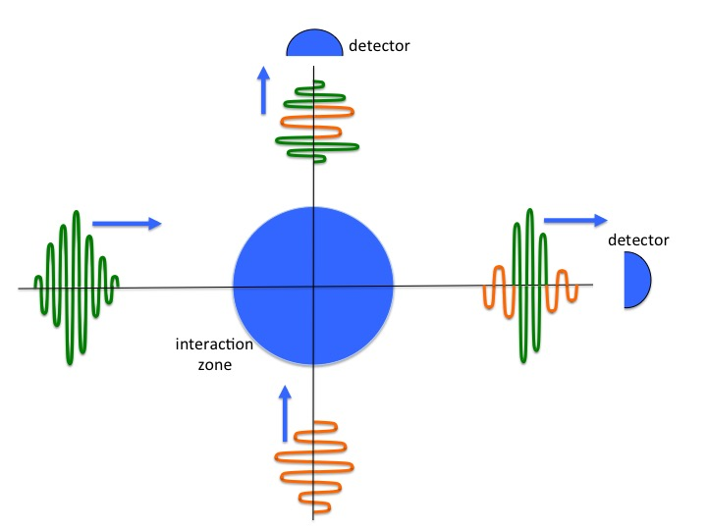
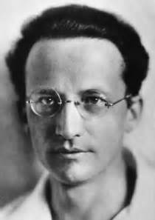
A way of visualizing entanglement
--Nick Herbert, Quantum Reality
Erwin Schrodinger: “Entanglement is the characteristic trait of quantum mechanics” [Schrodinger’s emphasis].

Slide 8
The apparent paradox of Schrodinger's cat
The entangled superposition |Ψ>_{M} = (|ψ₁>|1> + |ψ₂>|2>)/√2 is puzzling.
At least, and thought so.
The sad story of Schrodinger’s cat:
• Schrodinger: “The psi-function of the entire system would …have in it the living and dead cat (pardon the expression) mixed or smeared out in equal parts.”
• von Neumann analysis implies cat and nucleus are entangled:
(|undecayed> |live> + |decayed> |dead>)/√2

Slide 9
The measurement paradox: (|undecayed> |live> + |decayed> |dead>)/√2 looks like a superposition of “smeared out” states, with no definite outcome. This cannot be!
But does QM really predict this?
There’s more to |Ψ>_{M}
than meets the eye.

Slide 10
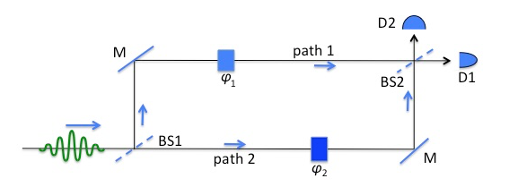
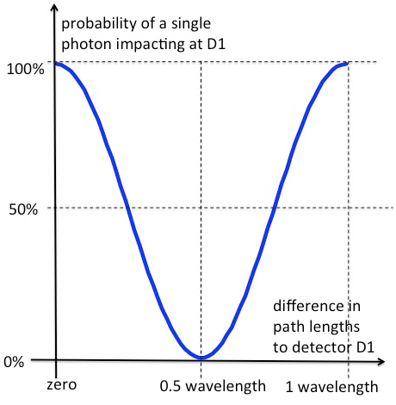
|Ψ>_{M} is an entangled superposition state.
A simple superposition:
Varying the phase shifters provides evidence the photon travels both paths:
The photon is in the superposition
|ψ> = (|ψ₁> + |ψ₂>)/√2

Slide 11
Technical detour
Density operators are convenient for analyzing composite systems
Def: Density op for system: ρ = |Ψ>_{M} _{M}<Ψ|.
Expectation values found from
<O> = Tr (ρ O ) for any observable O.
Theorem: For a composite system with subsystems A and B, predictions for one subsystem can be found from the ”reduced density op” ρ_{A} = Tr_{B} ρ as follows: <O_{A}> = Tr (ρ_{A} O_{A} )
These values are what an observer of only one subsystem would see.

Slide 12
Reduced density ops for |Ψ>_{M} _{M}<Ψ|:
ρ_{A} = (|ψ₁> <ψ₁| + |ψ₂> <ψ₂|)/2
ρ_{B} = (|1> <1| + |2> <2|)/2.
These are not superpositions. Not single quantum states at all. They are ”mixtures.” They predict repeated trials will find 50% of the cats dead, 50% alive—just as expected!
An observer of the cat sees a dead or alive cat, not both.
This has been known for decades: Josef Jauch, Foundations of QM (1968), & many others.
Problem solved? Unfortunately, no:
Others have criticized this use of reduced density operators (basis ambiguity, improper density operators).
We’ll see that Jauch (& others) were right.

Slide 13
Today’s opinion
No consensus.
Variety of re-interpretations of QM.
A few revisions of QM.
Variety of “epistemic”--wave function not physically real (Bohr)--interpretations.
Mostly: shut up and calculate.

Slide 14
2. Suggested resolution, based on nonlocality
Take a closer look at the entangled superposition |Ψ>_{M} = (|ψ₁>|1> + |ψ₂>|2>)/√2.
It’s a superposition, but not a simple superposition like |ψ₁> + |ψ₂>)/√2.
To understand the
simple superposition,
we studied an example.
By varying the phase, we saw that the photon was in a superposition of both states.
So: To better understand |Ψ>_{M} we should vary its phase.

Slide 15
Nonlocality experiments
Theorists (John Bell 1964) & experimentalists (Clauser 1972, Aspect 1982) have been varying the phases of entangled states for decades.
If the subsystems are simply photons (not cats), we can study the entire phase dependence of |Ψ>_{M}.
Entangled photons have been connected nonlocally and instantly across 1200 km (Pan 2017)
It’s gone un-noticed that this work has implications for Q measurements.
Chinese quantum satellite experiment

Slide 16
The experiments of Rarity and Tapster (1990) and of Ou, Zou, Wang, Leonard Mandel (1990), “RTO”.
Two photons in the entangled state |A1>|B1>+|A2>|B2>)/√2.
Two simple superpositions back-to-back, with photons already entangled in the state |Ψ>_{M} .

Slide 17
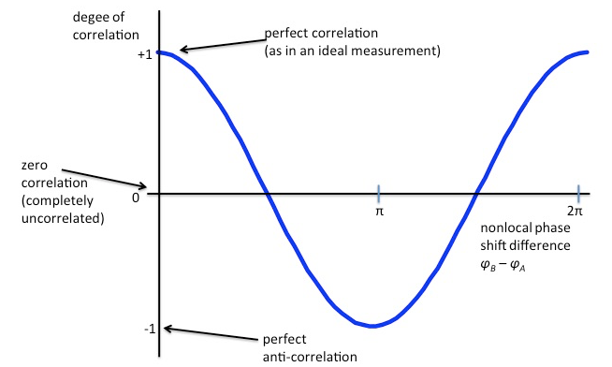
RTO: ENTANGLEMENT CHANGES EVERYTHING
Comparison of entangled pairs yields phase-dep. correlations between paired photons at different non-local phase angles φ_{B}–φ_{A} :
Entanglement destroys the interference of each photon with itself: no phase dependence at A1/A2 or B1/B2, only 50-50 mixtures.
Recall the “detector effect.”

Slide 18
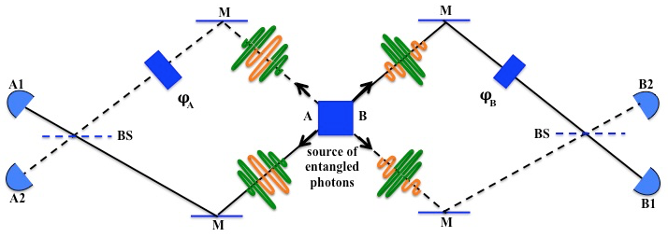
In more detail:
simple vs. entangled superposition:
Simple superposition: Entangled superposition of 2 photons:
φ₁–φ₂ State of photon φ_{B}–φ_{A} State of each Corr between them
0 100% “1”, 0% “2” 0 50-50 “1” or “2” 100% corr, 0% anti
π/4 70% “1”, 30% “2” π/4 50-50 “1” or “2” 70% corr, 30% anti
π/2 50% “1”, 50% “2” π/2 50-50 “1” or “2” 50% corr, 50% anti
3π/4 30% “1”, 70% “2” 3π/4 50-50 “1” or “2” 30% corr, 70% anti
π 0% “1”, 100% “2” π 50-50 “1” or “2” 0% corr, 100% anti
1 AND 2
1 OR 2
no paradox

Slide 19
These results follow from QM based only on:
An entangled state such as
(|undecayed>|live>+|decayed>|dead>)/√2 says:
“An undecayed nucleus is 100% correlated with a live cat, AND a decayed nucleus is correlated with a dead cat.”
This is not paradoxical.
• photons have a wavelength, • the photons are in the state |A1>|B1>+|A2>|B2>)/√2.

Slide 20
3. How to fix things so the ”cat” misconception does not arise.
A ”dyad” such as |A1>|B1> is usually understood as a single state ”A1 and B1” of a composite system AB.
It’s not. Experiment and theory tell us it is a positive correlation between state A1 of system A and state B1 of system B. It says ”You’ll find A in state A1 if and only if you find B in state B1."
Then (|A1>|B1>+|A2>|B2>)/√2 is not contradictory.

Slide 21
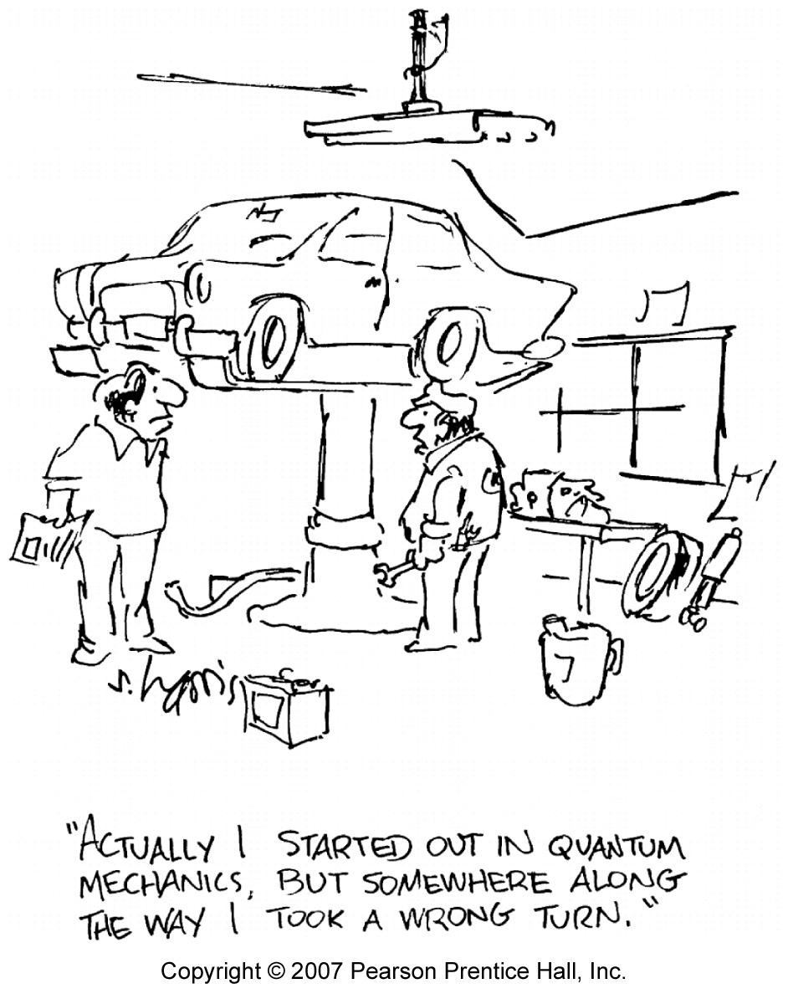
Thanks for your attention!
Acknowledgements:
Suren Singh, UA physics
Barry Ward, UA philosophy
James Malley, Nat. Inst. Health
Mario Bunge, McGill U
Ulrich Harms, Reutlingen, Germany
Peter Milonni, former UA physics
Also by AH:
• “There are no particles, there are only fields,”
Am J Phys, March 2013, pages 211-222.
• Tales of the Quantum, pub. by Oxford
University Press, 2017.

