Slide 1
The Debate over GLOBALIZATION:
An overview

Slide 2

What is Globalization?
no commonly accepted definition
means different things to different people
a complex phenomenon which includes a variety of topics and issues

Slide 3

Globalization
The term was popularized by Theodore Levitt in his article, “Globalization of Markets”, published in the Harvard Business Review, 1983, May-June issue.

Slide 4

What is “Globalization?”
“Globalization refers to increases in the degree of integration between national economies. Integration encompasses all of the ways national economies are connected in international markets, including trade in goods, services and ideas; international movements of the factors of production; and coordination of public policies.”
Focus: Globalization. NCEE, NY.

Slide 5

Globalization: key terms
Change
Expansion
Interaction
Integration
International markets
Technology
Trade
Interdependency

Slide 6

What is globalization?
Trade in goods and services
From 1960 – 2003:
  U.S. Exports increased by almost 800%
  U.S. Imports increased by 1,300%
  Imports grew from 4.2% to 13.8% GDP
  Exports grew from 4.9% to 9.3% GDP

Slide 7

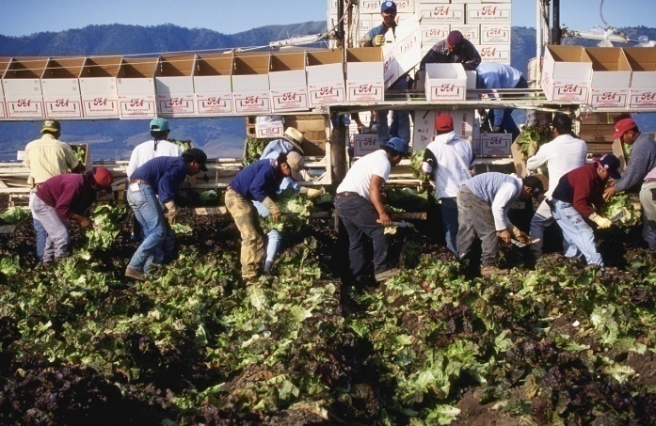
International mobility of labor
2001 – 31.8 million immigrants made
up 11% of the nation’s population
2001 – US had 20 million immigrants in the labor force, comprising 13.9% of the labor force—approximately twice as high as in the 1970’s

Slide 8

International Mobility of Capital
In 2003, U.S. agents owned $7.8 trillion of foreign financial assets
Foreign agents owned
$10.5 trillion of U.S. financial assets
A sizable fraction of US capital stock is owned by foreign citizens

Slide 9
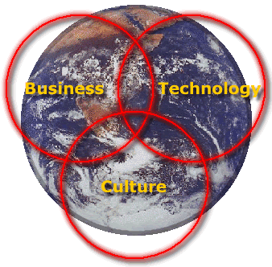
Integration: Old and New
Changes in what is traded
Changes in how trade is conducted and how countries are integrated

Slide 10
Integration: Old and New
Growth of Multi-national Corporations (MNC)
Foreign Direct Investment (FDI)

Slide 11
Multinational Corporations
Company/Product | Owned by
Shell Gas
7 Up
Bayer Aspirin
Burger King Hamburgers & Fries
Crowne Plaza Hotel
Houghton Mifflin Book
Snapple Ice Tea
Skippy Peanut Butter

Slide 12
Multinational Corporations
Company/Product | Owned by
Shell Gas | Royal Dutch Shell
7 Up | Britain’s Cadbury Schweppes
Bayer Aspirin | Bayer AG in Germany
Burger King Hamburgers & Fries | British Diageo
Crowne Plaza Hotel | British hotel firm Six Continents
Houghton Mifflin Book | French Vivendi Universal
Snapple Ice Tea | Britain’s Cadbury Schweppes
Skippy Peanut Butter | Unilever, Anglo-Dutch Company

Slide 13
Integration: Old and New
U.S. less reliant on trade than most other countries
U.S. exports as a % GDP are comparable to what they were in 1880.

Slide 14
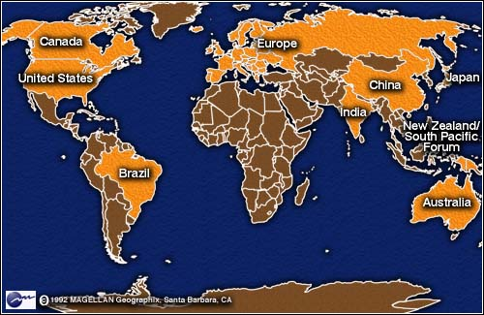
II. Why Countries Trade
  Specialization
  Arbitrage
  Absolute Advantage
  Comparative Advantage
  Gains from Trade

Slide 15

Sources of comparative advantage
Differences in endowments of natural resources
Government services and regulations
Investment in technology
Differences in the supply of key inputs
International migration and capital flows
Activity

Slide 16
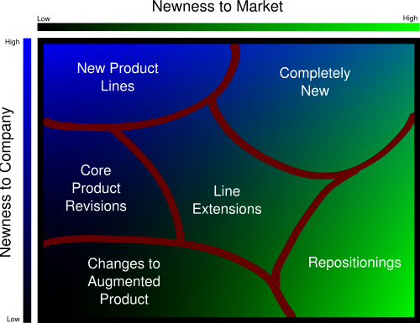
Other reasons for trade
  Differentiated Products
  Consumer tastes and preferences
  Multinational firms

Slide 17

III: Trade Policy
Governments often impose restrictions
Tariffs and other trade barriers

Slide 18

Political explanations for Protection
Unaware how protectionist policies reduce or eliminate gains from trade
Objectives other than maximizing economic welfare
Focus on who wins/loses versus overall gains from trade

Slide 19
Losses from Trade in Factor Markets
Unemployment—international trade can cause short-run dislocations as workers change jobs
Not everyone shares equally in gains from trade
Job displacement costs vary among workers
Federal assistance exists for workers displaced by import competition
Physical capital losses versus financial capital losses

Slide 20
Trade and Returns to Education
Recent increase in “skill premium”
In 1973, college graduates earned 32% per year more than high school grads
By 1993, college graduates earned 56% per year more than high school grads

Slide 21
V. Trade and International Institutions
WTO—formerly GATT
Regional agreements such as NAFTA, EU, ASEAN, MERCOSUR, CAFTA, etc.
General focus on tariff reduction
Notes:
WTO an outgrowth of GATT. International organization estb. In 1995 to promote int’l

Slide 22

Trade and International Institutions
International Monetary Fund
World Bank

Slide 23

Agriculture and Textiles
Historical protection with tariffs, quotas and subsidies among high income nations for agricultural and textile/apparel products denies access to their markets by lower income nations
Multi-Fiber Accord
WTO

Slide 24

Environmental Standards
Regulation can become a source of comparative advantage
Environmental standards uneven among countries
Some pollution problems are global
“Pollution havens”

Slide 25
Labor Standards
Laws and regulations on treatment of workers vary widely across countries
Wages vary across countries
Productivity and standard of living
Trade policies can increase productivity, income and standards of living

Slide 26



Product Standards
Globalization has implications for countries’:
  Health standards
  Safety standards
  Food regulations
  Globalization creates incentives for harmonization of regulations and policies

Slide 27
Conclusion
Globalization presents a paradox
We trade because we are different, yet trading makes us more alike!
Trade increases product diversity and differentiation.
Globalization creates pressure on policy makers to make policies more similar.
Cultural convergence or divergence?

Slide 28

Focus: Globalization
NCEE publication, fall 2006
300 pages
Introductory essay
12 student-centered lessons

Slide 29

Focus: Globalization
All lessons include:
  Lesson description
  Introductory paragraph
  List of concepts
  Voluntary National Content Standards in Economics
  Benchmarks
  Learning Objectives
  Estimated time required
  Materials—Visuals and handouts
  Procedures
  Assessment activities

Slide 30

Other resources
www.econedlink.net
www.globalization101.org
www.worldbank.org
www.imf.org
www.atkearney.com
www.heifer.org

Slide 31
Appendix A: Critics of Globalization and IMF
Stiglitz and others have raised serious questions about:
International Monetary Fund

Slide 32


Critics of Globalization and IMF
Asks governments to give up the ability to run fiscal deficits
Budget cuts often reduce/eliminate assistance program
Multinational Banks who lend, often benefit by eliminating risk of loan defaults.
Recovery in many countries is slow.

Slide 33
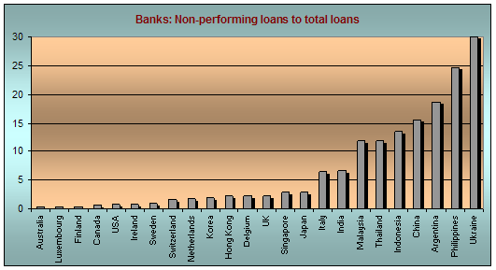
IMF Proponents claim:
Governments are not forced to take IMF loans
Many countries are already in dire distress when they ask for IMF help
Government deficit spending is often the cause of many problems

Slide 34
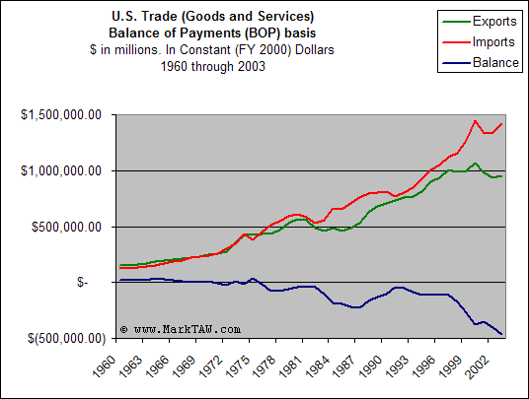
Appendix B: What is a Trade Deficit?
Linking trade and investment
Trade deficits and
trade surpluses
Is a trade deficit a
serious problem?

