Slide 1
Economic Dimensions of Arkansas History
Bessie B. Moore Center for Economic Education
Sam M. Walton College of Business
University of Arkansas

Slide 2
Pride in Arkansas
Notes:
Title Page:
Pride in Arkansas
Edits – for each section, let’s have famous people, places, entrepreneurs, and businesses integrated into the natural scenes. Also, a few of the parks in that region.

Slide 3
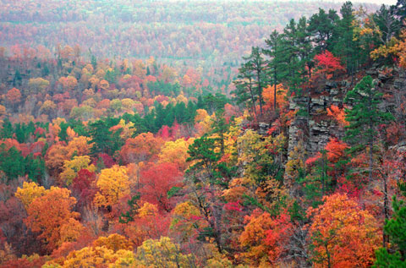
The Natural State
Ozark Mountains
Notes:
The Natural State
Several slides with pictures of Arkansas

Slide 4
Pride in Arkansas
Arkansas students need to understand and value:
the diverse landscapes of the state
the people – both commoners and leaders
the entrepreneurs
the companies – employment
the cities – market centers, places to work & live
the parks – history, recreation, relaxation
the festivals recognizing traditions & history

Slide 5
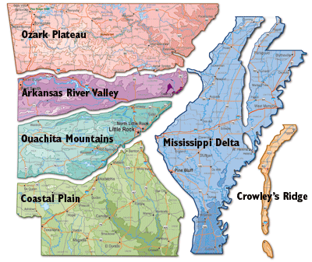
Six Geographic Regions
Notes:
Due to the distinct geographic features, AR has a very diverse landscape. Initially, the wealth of the state was generated from the delta and the cotton plantations. Then with the development of railroads and the timber industry is moved to the coastal plains. Timber did also come from the Ouachitas and the Ozark highlands. Then when oil was a driving economic factor, the gulf coastal plains again held much of the wealth. During this period Little Rock, as the capital, was also experiencing economic growth. In the late 20th century, the Northwest Arkansas area became an economic leader with the growth of companies such as Jones Truck Lines, Willis Shaw Trucking, J. B. Hunt Transportation, Tyson Foods and Walmart.

Slide 6
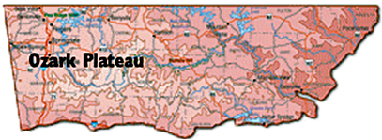
Ozark Plateau
Notes:
Separate each region by the section of map growing and the give details about region
- List a few key parks in each region.

Slide 7
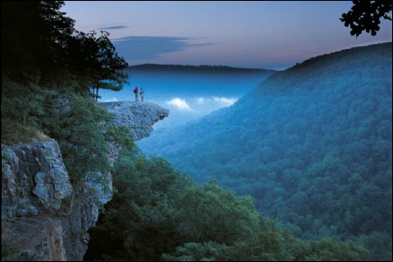

Slide 8
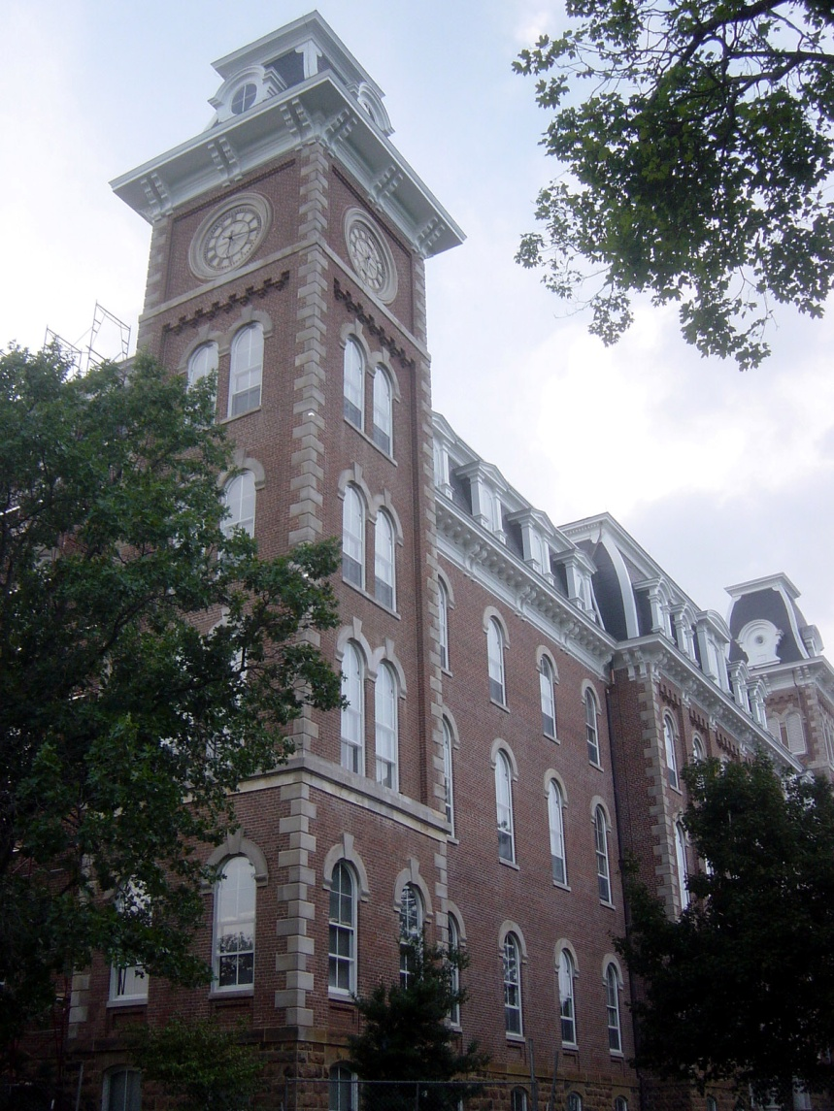
University of Arkansas
Old Main
Go Razorbacks!

Slide 9
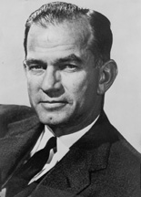
J. William Fulbright (1905 – 1995)
Representative and Senator from AR
President of U of AR
Founder of Fulbright Scholars program

Slide 10
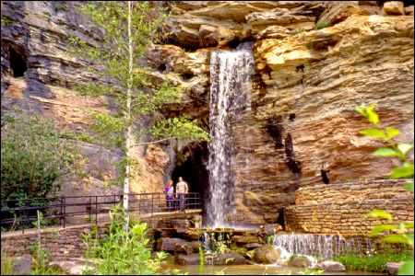
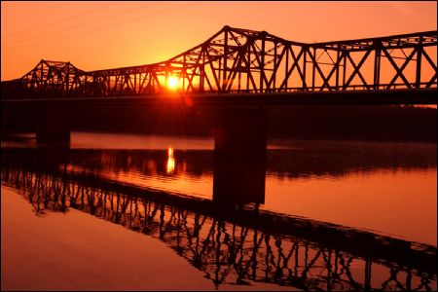
Lake Fort Smith
Hurricane River Cave
Greer's Ferry Lake Bridge

Slide 11
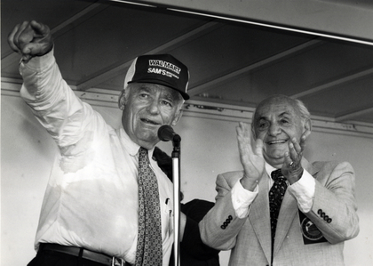
Samuel Moore Walton
Born March 29, 1918
Graduated in 1940 with a B.A. in Economics
Founder of Walmart
First Walmart opened in July 1962 in Rogers, Arkansas

Slide 12
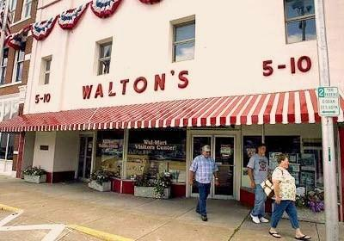
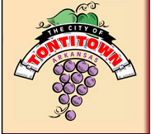
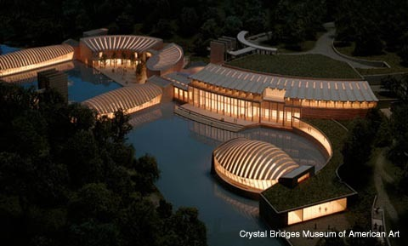
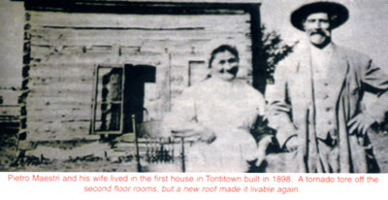
Tontitown
Catholic immigrants
Lead by Father Bandini
Tenant farmers on Sunnyside Plantation
Grape Festival
Bentonville
Walton’s Five and Dime
Crystal Bridges
Walmart Home Offices

Slide 13
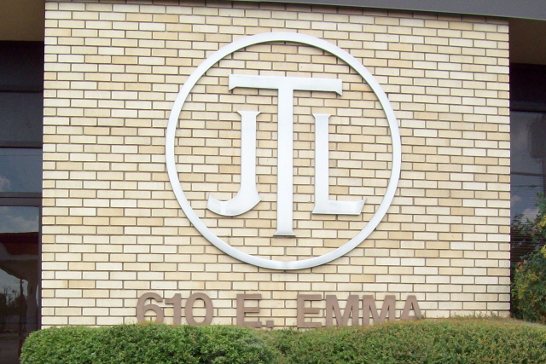
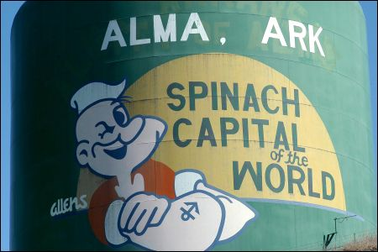
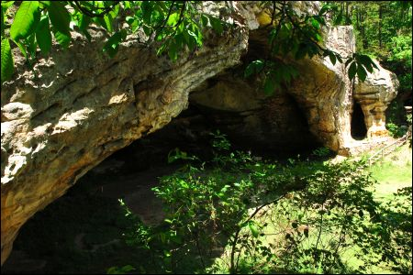
Jones Trucking Lines
Historially, Steele Canning Company – now Allens
Willis Shaw Express
Frozen and Refrigerated Trucking
Indian Rockhouse Cave, Fairfield Bay

Slide 14
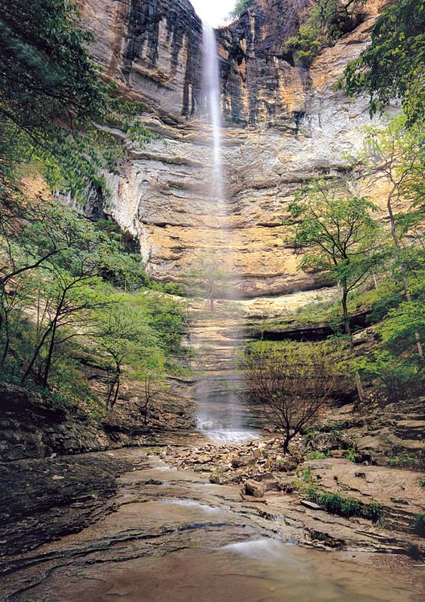
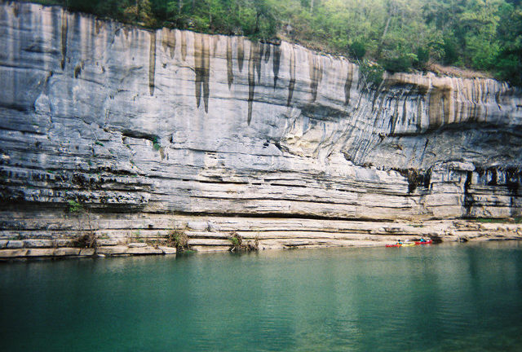
Buffalo River National Park
First national river
Hundreds of miles of trails
Canoeing, kayaking & fishing

Slide 15
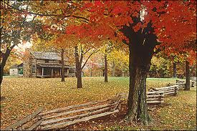
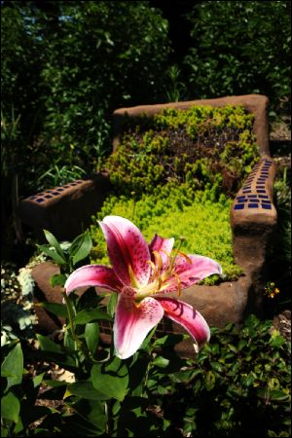
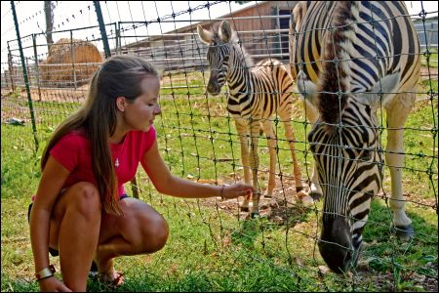
Prairie Grove Battle Field Park
Botanical Garden of the Ozarks
Gentry Animal Park

Slide 16
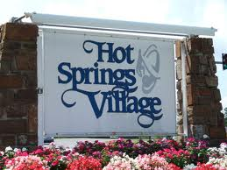
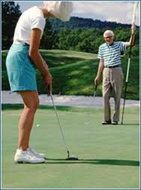
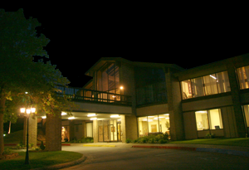
Retirement Communities
Bella Vista
Cherokee Village
Hot Springs Village

Slide 17
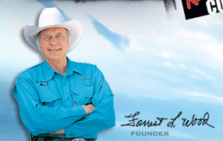
Forrest Lee Wood (1932 - )
Began to build lake boats in 1968
Produced six boats that year and started to get noticed
In 1972 Ranger was named “the official Bassmaster Classic boat”. Ranger held that title until 2000.
In 1998 Wood started a seven-year term with the Arkansas Game and Fish Commission

Slide 18
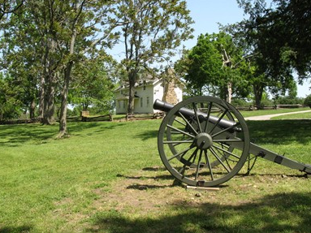
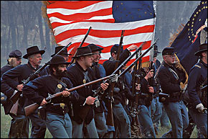
Historical Parks
Pea Ridge National
Military Park
Prairie Grove Battlefield
State Park

Slide 19
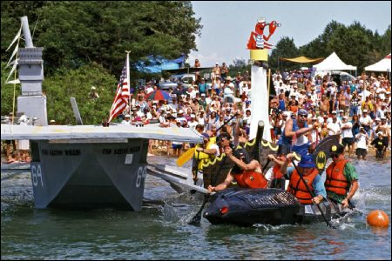
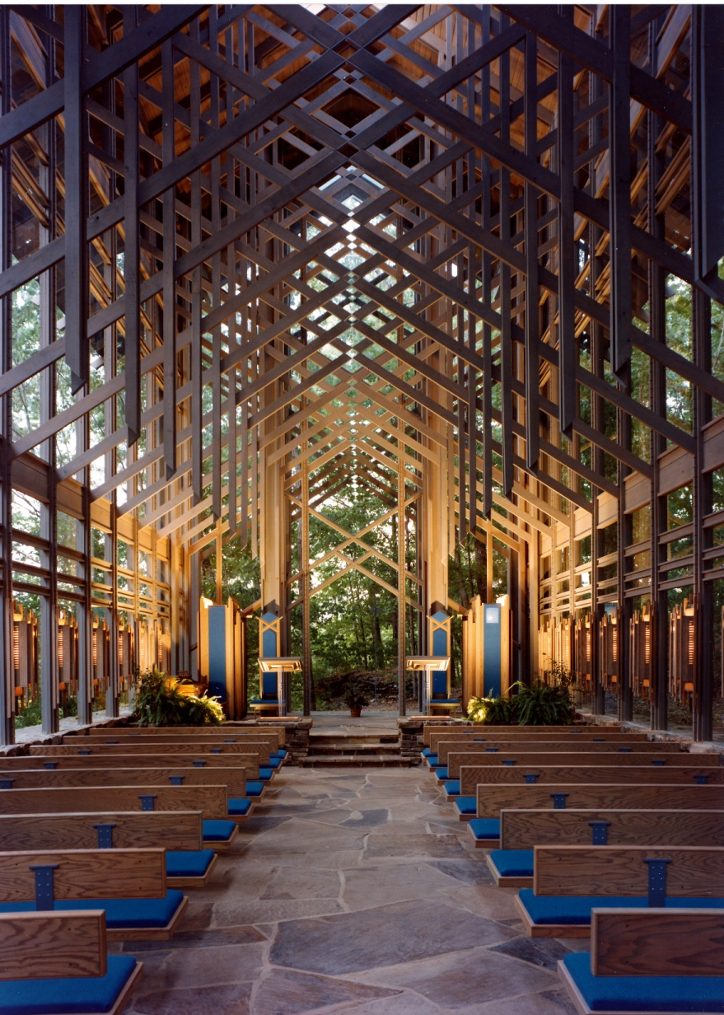
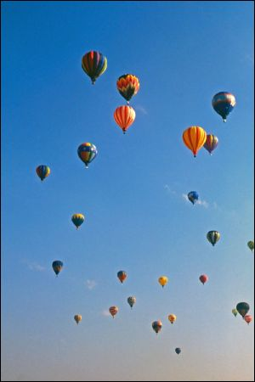
Arkansas Hot Air Balloon State Race
World Champion Boat Races in Heber Springs
Thorn Crown Chapel
E. Fay Jones

Slide 20
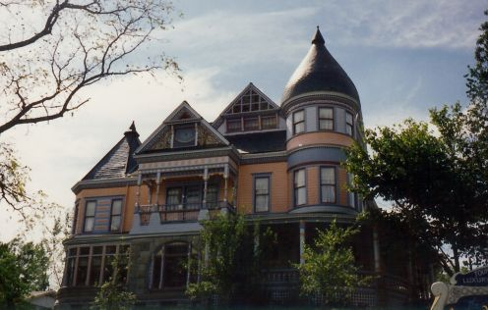
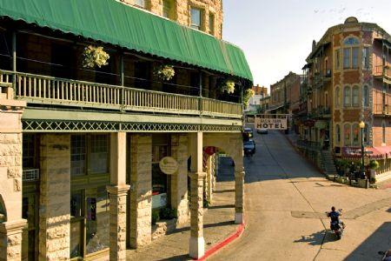
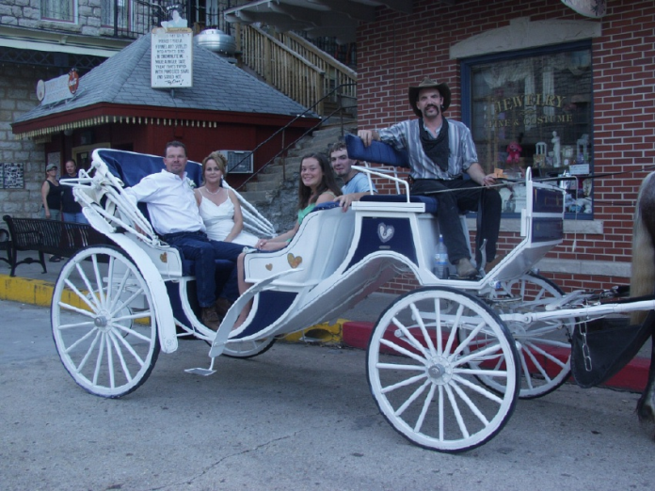
Eureka Springs
Victorian town in Ozark Mountains
Known for healing waters

Slide 21
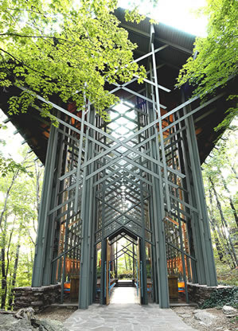
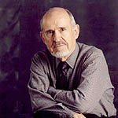
E. Faye Jones (1921 – 2004)
Born in Pine Bluff
Architect and Professor in Fayetteville
Internationally recognized

Slide 22
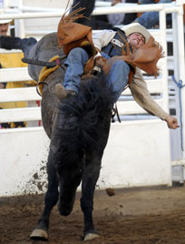
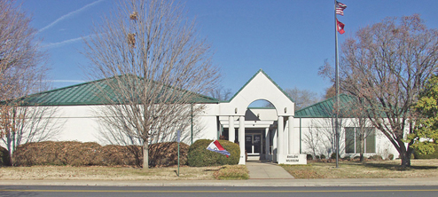
Springdale
Shiloh Museum of Ozark History
Jones Center for Families
Tyson Foods
Rodeo of the Ozarks

Slide 23
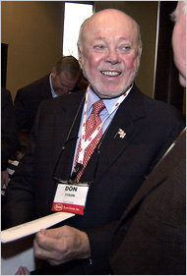
Donald J. Tyson (1930 – 2011)
Born in Olathe, KS
Attended school in Springdale
President and CEO of Tyson Foods
Avid fisherman

Slide 24
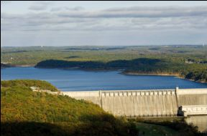
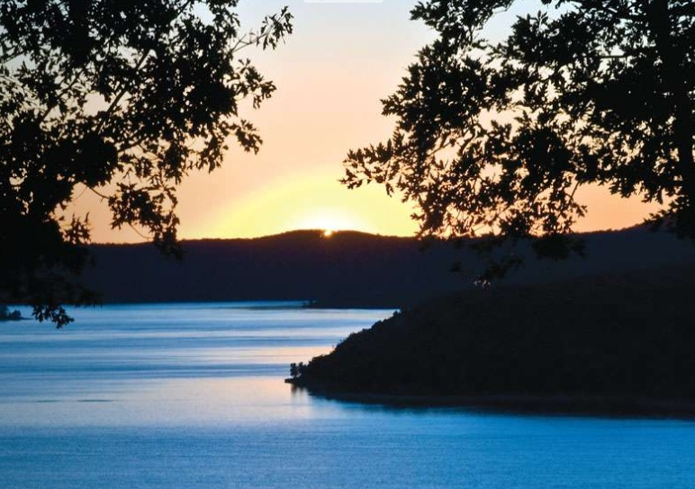
Recreation & Water Supply
Beaver Lake
Bull Shoals Lake

Slide 25
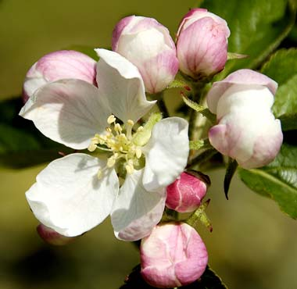
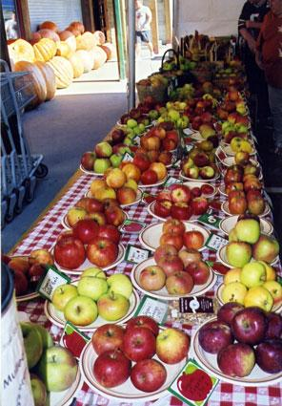
Lincoln, AR

Slide 26
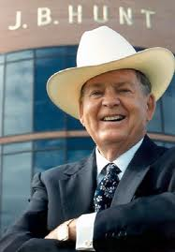
Johnnie Bryan Hunt, Sr. (1928 – 2006)
Born in Heber Springs
Founded J. B. Hunt Transport Services in Lowell, AR

Slide 27
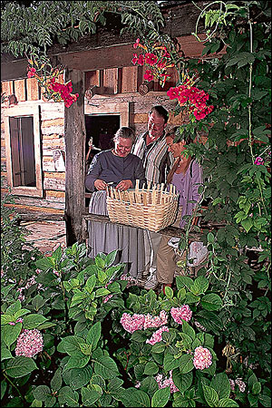
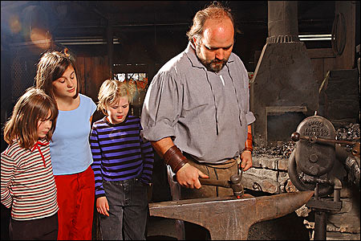
Ozark Mountain Folk Center

Slide 28
Arkansas River Valley

Slide 29
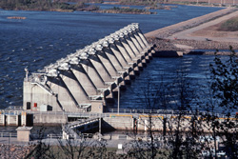
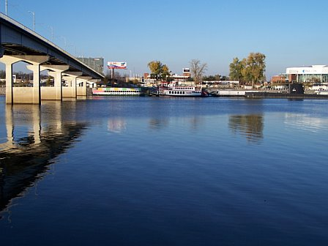
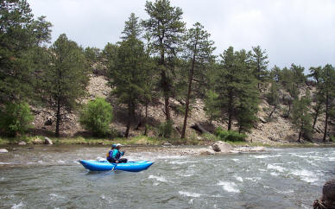
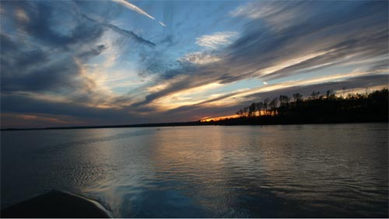
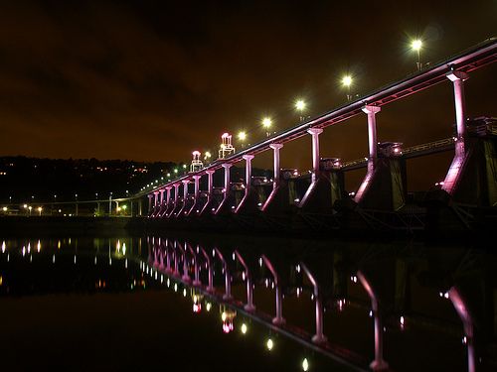
Arkansas River

Slide 30
Historic Crawford County Courthouse
Hang Gliding at Lake Dardanelle
Winrock Second Saturday Chef Program

Slide 31
Fort Smith
Judge Isaac C. Parker
Fort Smith National Historic Site
Weldon, Williams & Lick, Inc.
Hanging Judge Parker

Slide 32
Atkins
Atkins Pickle
Festival

Slide 33
German – Swiss Immigrants
Altus Grape Festival

Slide 34
Wiederkehr Weinkellar Restaurant
Chateau Aux Arc – Altus, AR
The Wine Country of Altus

Slide 35
View from the highest point in Arkansas
Morning at Mount Magazine
Petit Jean State Park

Slide 36
Paris, AR

Slide 37
Ozark

Slide 38
Russellville

Slide 39
Clarksville

Slide 40
Heifer International Ranch - Perryville, AR
Fort Smith Museum of History

Slide 41
Ouachita Mountains

Slide 42
Turtle Cove Spa at Mountain Harbor
Mountain Harbor lake in the
Ouachita National Forest
Rock climbing in the Ouachita Mountains

Slide 43
Hot Springs
Bathhouse Row
Garvan Gardens
Chapel by E. Faye Jones

Slide 44
Oaklawn Racetrack in Hot Springs
Mid-America Science Museum

Slide 45
Mountain Valley Spring Water
Pristine
Naturally high pH
Minerals: calcium carbonate, iron & manganese

Slide 46
Alan Ladd (1913 – 1964)
Star on Hollywood Walk of Fame
Billy Bob Thornton (1955 - )
Academy Award Winner
Hot Springs
Notes:
Sling Blade,

Slide 47
Lookout Point Lakeside Inn Hot Springs, AR
DeGray Lake Resort State Park
Garvan Gardens

Slide 48
Ouachita River
Juanita’s Candy Kitchen in Arkadelphia

Slide 49
Gulf Coastal Plain

Slide 50
Fishing in Crossett
Loggers at Crossett

Slide 51
William Jefferson Clinton (1946 - )
42nd President of the United States
Wife is Hillary Rodham Clinton
Highest end of office approval rating of any president since WWII
Juris Doctor from Yale Law School
Born in Hope, AR
Lived in Hot Springs, AR
BS in Foreign Service from Georgetown University in Washington, D.C.
Rhodes Scholar – University College, Oxford – studied philosophy, politics and economics
Law professor at University of Arkansas
Governor of Arkansas – education reform

Slide 52
Lake Columbia – Magnolia
Two Rivers Museum Ashdown

Slide 53
Hope
Paul W. Klipsch –
Klipsch (speakers),
Bill Clinton’s Boyhood Home

Slide 54
Old House and Wagon, Gould
Pumpkins of major size at Hardin Farms
Beautiful sunset on De Queen Lake

Slide 55
El Dorado
Population 18,884
South Arkansas Community College
South Arkansas Arts Center
Best known as being the heart of the 1920s oil boom in South Arkansas, earning it the nickname “Arkansas’s Original Boomtown”.

Slide 56
Charles H. Murphy Jr. (1920 – 2002)
Murphy became the leader of his family business in 1941 at the age of twenty-one.
Murphy Corporation developed properties in several states and also participated in the development of oil-producing properties in the Gulf of Mexico, the North sea, Canada, and Venezuela.
He was active as a lecturer on economics, responsible civic actions, energy, and education, never charging a fee.
El Dorado, AR

Slide 57
Grampas Lake, Hamburg
The Murals of Camden
Glass Blowing in Grady

Slide 58
Scott Joplin (1867 – 1917)
King of Ragtime
Texarkana
After school hours learning to play the piano
Composed Maple Leaf Rag
Works featured in The Sting

Slide 59
Smoke on the Water Festival – Pine Bluff
Logoly State Park

Slide 60
John R. Johnny Cash (1932 – 2003)
Born in Kingsland, AR
Lived in Dyess, AR
Sang & worked in cotton fields
Singer-songwriter
Country, rockabilly, blues, folk and gospel
‘The Man in Black’
Folsom Prison Blues
I Walk the Line
Ring of Fire
A Boy Named Sue

Slide 61
Pink Tomato Festival

Slide 62
Harry Thomason & Linda Bloodworth-Thomason – Designing Women producers
Born in Hampton, AR
Dee Alexander Brown (1908-2002)
Bury My Heart at Wounded Knee
Novelist and historian

Slide 63
Smackover
Arkansas Museum of Natural Resources

Slide 64
Crude Oil
Gulf Coastal Plains – Union, Lafayette, Columbia & Ouachita
S. T. Busey Well

Slide 65
Glen Campbell (1936 - )
Scottish sharecropper father
Delight, AR
CMA Male Vocalist of the Year
ACM Entertainer of the Year
Played with John Wayne in True Grit
Country Music Hall of Fame
27 songs in top 10
Gentle on My Mind
Rhinestone Cowboy
Wichita Lineman

Slide 66
Mississippi Delta

Slide 67
Mississippi River

Slide 68
King Biscuit Blues Festival
Helena, Arkansas
Zac Harmon & Jeff Stone

Slide 69
Millers Mud Mill Pottery - Dumas
The Delta Queen
Crawfish festival in Dermott

Slide 71
Riceland Foods
Farmers Cooperative since 1921
Headquarters in Stuttgart
World’s largest miller and marketer of rice
Rice exporter & oil producer
Marketing services for rice, soybeans & wheat
9000 farmer members in AR, LA, MS, TX
Labels: Riceland, Chef-way & private
Products sold in US and in 75 countries
1900 employees process 125 M bushels of grain

Slide 72
Farming in Eudora
Marianna Cotton
Rice harvesting in Gillett area

Slide 73
Plantations…

Slide 74
Delta Heritage Trail in Helena
Sissy Jones – Sissy’s Log Cabin
Pine Bluff
Because life is too short for ordinary jewelry
Entrance to Lake Poinsett
State Park, Harrisburg

Slide 75
Post National Memorial Museum
White River Refuge Cypress in Fall
Southland Gaming & Racing – West Memphis

Slide 76
Hazen, Arkansas
The Imperial Dinner Theatre - Pocahontas
Pine Bluff – Stephen L. LaFrance

Slide 77
Jackson County Courthouse in Newport
Lake Chicot Fishing – Mississippi River
Paragould Mural

Slide 78
Parkin Archeological State Park
Duck Calling Festival
Arkansas Post Museum
Delta Heritage Trail State Park

Slide 79
Crowley’s Ridge

Slide 80
Crowley’s Ridge State Park

Slide 81
Jonesboro

Slide 82
John Grisham (1955 - )
Jonesboro
Attorney in Mississippi
Served in MS house of
representatives
Modern legal thriller author
Writes one book per year
Books include: The Firm, Pelican Brief, The Client,

Slide 83
Central Region

Slide 84
Little Rock – the capital of Arkansas
Old State House Museum
Central High School

Slide 85
Douglas MacArthur (1880 – 1964)
Born in Arsenal Barracks in LR
Raised in army posts in the Old West
Graduated first in his West Point class
Medal of Honor for Philippines Campaign
Five star U.S. Army General
Florence Price (1887 – 1953)
First black female
symphonic composer in US
Taught in AR 1907- 1927
Moved after lynching in LR
Symphony no. 1 in e minor
Ethiopia’s Shadow in America
Mississippi River, sym.

Slide 86
William J. Clinton Presidential Center

Slide 87
Frank and Georgia Hickingbotham

Slide 88
Arkansas State Symbols
Mockingbird
Diana Fritillary
Apple Blossom
Notes:
Flag Page that has the Flag, butterfly, flower, etc.,

Slide 89
Natural Resource Rich
Notes:
Economic RESOURCES
Economy, mining, oil pumping, cotton, wine pic, rice capital of the world
Land, farms, hills, swamps
Water, lake, rivers
People, farmers, musicians, business people, african american, italian, hispanic
Houses, time period of houses

Slide 90
Arkansas Parks
There are more than 50 state parks in Arkansas
Mammoth Spring State Park
Bird watching at Lake
Chicot State Park
Devil’s Den State Park
Daisy State Park
Photos and information provided by Arkansas.com
Notes:
Arkansas Parks – more than 50 state parks. Show 1 or more from each region. Make note at the bottom of PP of where I got photos and information.

Slide 91
Arkansas Top 20
Notes:
Top 20 and logo’s

Slide 92
Economic Dimensions of AR History
Bessie B. Moore Center for Economic Education
Dr. Rita Littrell

Slide 93
Curricula
Ice breaker – with answers
Pride in Arkansas PowerPoint
Regional PowerPoints
Lesson with maps serving as graphic organizers
Map locator activities
Presentation evaluation forms
Content summaries
Online Jeopardy format game
Website has many additional lessons

