Slide 1
Stories of Change Agents: Leaders who solved social, environmental or economic issues.
Bessie B. Moore Center for Economic Education
Sam M. Walton College of Business
University of Arkansas

Slide 2
What problem do you want to solve?

Slide 3
Stories of Change Agents
Students read children’s book about Nobel Laureates and other true stories of change agents from countries around the world.
They create a video, story board, mural or other means of communicating the story to their classmates.
They assign Sustainable Development Goal awards to each book.
Essential Question: What are examples of ways people from around the globe have created social, environmental or economic change?

Slide 4
Education & Income Story of Heifer International and the passing on of the gift. ---Uganda

Slide 5
Health Care Story of value of health care prevention, education and services. ---Kenya

Slide 6
Higher Education, Entrepreneurship & Microloans Story of the benefits of entrepreneurial thinking. ---Ghana

Slide 7
Entrepreneurship & Women’s Rights Story of a determined girl who makes her dream come true ---Ethiopia

Slide 8
Education Giving back to a village after a mountain rescue ---Pakistan

Slide 9
Education Story of a determined girl who wants to go to school ---Cambodia

Slide 10
Value Added & Sharing Scarce resources, production & sharing ---Kenya

Slide 11
Education Building a school using available resources ---Chad

Slide 12
Entrepreneurship A story of innovation, discovery, and economic development. ---Mexico

Slide 13
Infrastructure Tale of a donated bicycle and the ways it makes a difference. ---Burkina Faso

Slide 14
Education Shows many ways books are delivered or shared.

Slide 15
Education of Girls Learn of challenges of girls’ getting an education ---Afghanistan

Slide 16
Value Added Solving an environmental problem and production. ---The Gambia

Slide 17
Sustainable Farming Maria learns to stop erosion, grow diversified plants, and to enrich the soil. ---Honduras

Slide 18
Education of Girls Value of education after loss and despite restrictions from the Taliban ---Afghanistan

Slide 19
Banking Sector Learn the story of the father of social enterprise as he founded the first micro-loan program ---Bangladesh

Slide 20
Trade Specialization and markets allow for increased productivity ---Mexico

Slide 21
Potable Water How far do you travel for safe and clean water? --Burkina Faso

Slide 22
Trade Specialization in a Haitian market ---Haiti

Slide 23
Education of Girls Benefits of education girls ---Pakistan

Slide 24
Trade & Infrastructure Market experience and transportation --- Haiti

Slide 25
Education Providing books where they are scarce ---Colombia

Slide 26
Environmental Restoration Founder of the green belt movement and Nobel Laureate --- Kenya

Slide 27
Environmental Conservation True story of man who healed through caring for animals --- India

Slide 28
Ingenuity Young boy who through determination brought electricity and water to his village ---Malawi

Slide 29
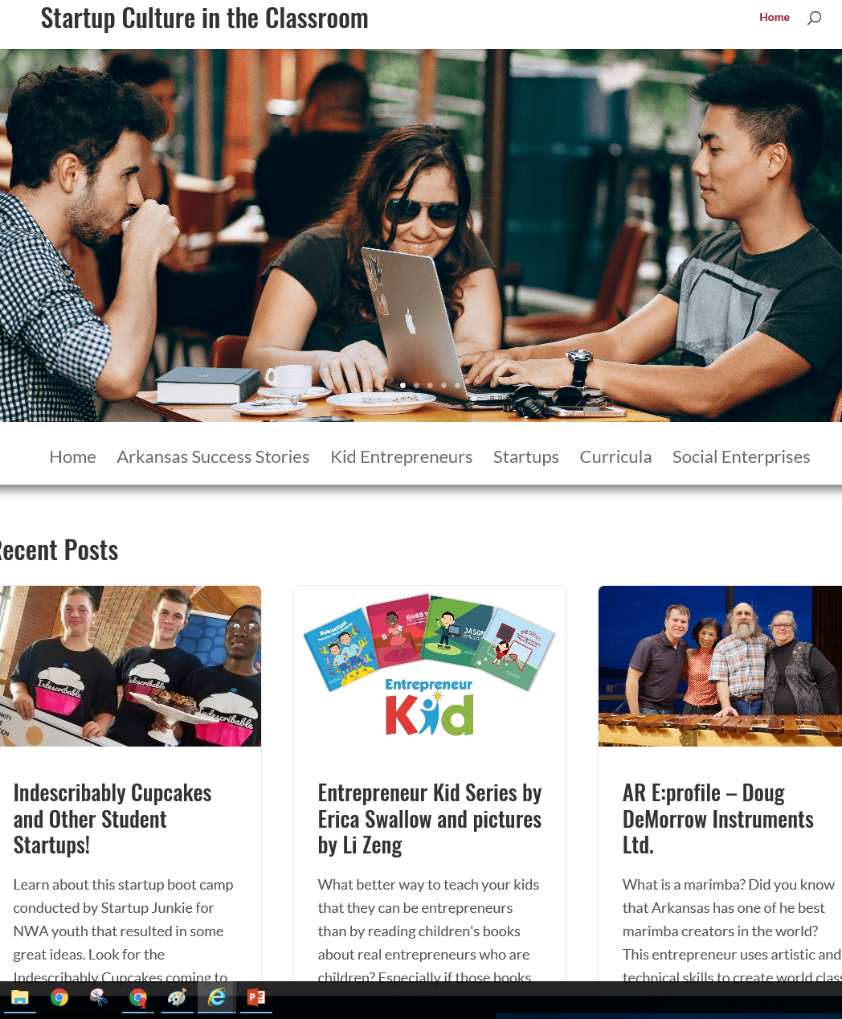
Additional Resources:
Startup Culture Blog:
sites.uark.edu/startupculture
Online activities on Arkansas Entrepreneurs:
http://naturalstateentrepreneurs.weebly.com/

Slide 30
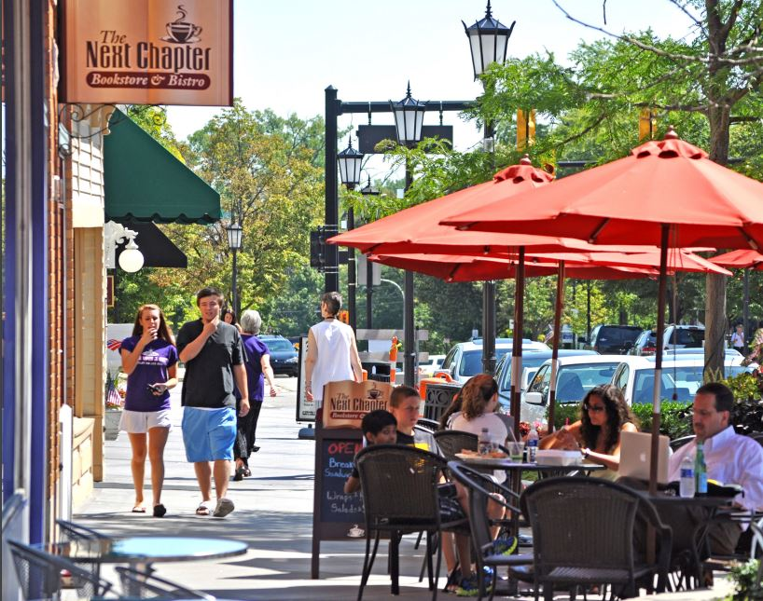
For assistance on community service projects or social enterprise:
Dr. Rita Littrell – rlittrell@Walton.uark.edu
sites.uark.edu/startupculture

