Slide 1
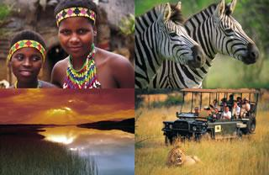
Bessie Moore Center for Economic Education
Republic of South Africa
Rita Littrell

Slide 2
Bessie Moore Center for Economic Education
Welcome to Our Guests
Karen Dos Reis
Alex Pinnock
Seymour Bothman
Rudolph Cornelissen

Slide 3

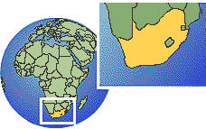
Location
South Africa, is the southern tip of the continent of Africa
Twice the size of Texas

Slide 4
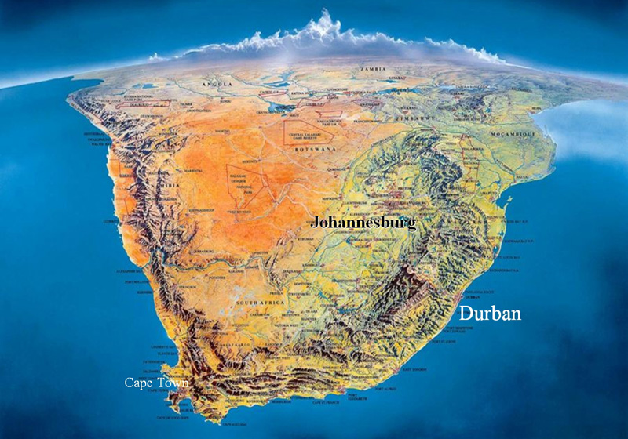

Slide 5
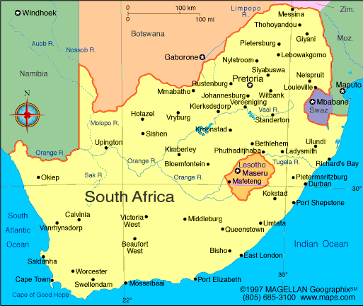
Land Boundaries

Slide 6

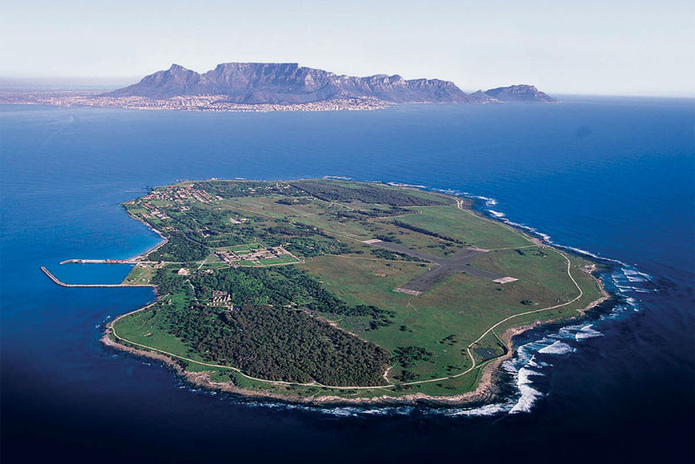

Slide 7
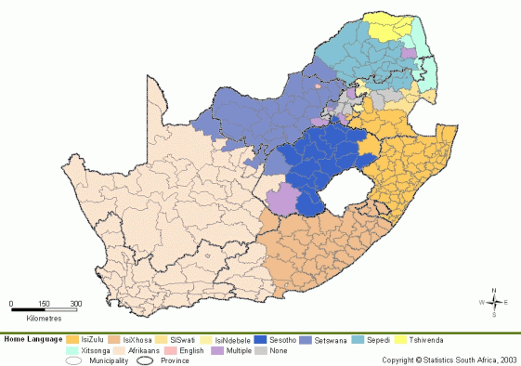
Language
There are 11 officially recognized languages, most
of them indigenous to South Africa
The names of a few of them are:
  isiZulu
  isiXhosa
  Afrikaans (a derivative of Dutch)
English is the language of the cities, of commerce and banking, of government, of road signs and official documents. The President makes his speeches in English. At any hotel, the receptionists, waiters and porters will speak English.

Slide 8
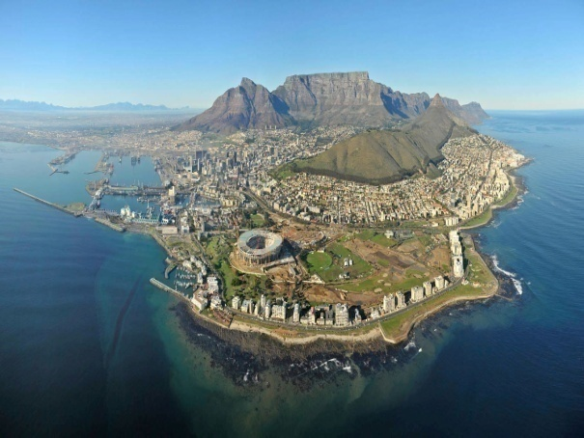
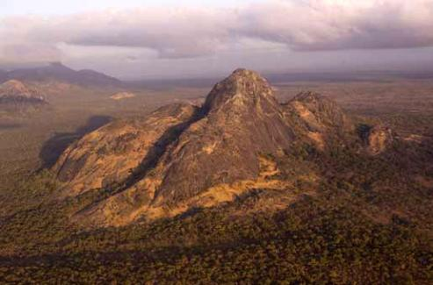
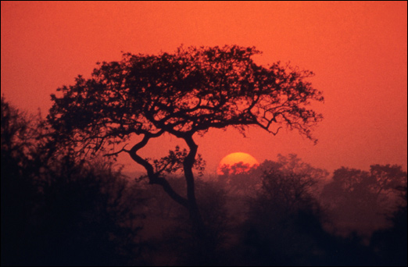
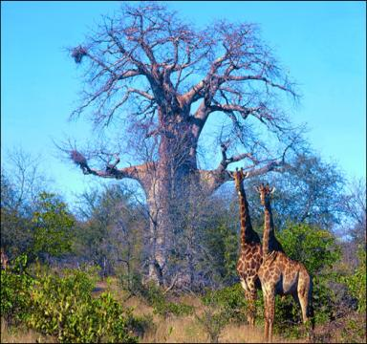
Climate
Diverse Climate
Terrain
Vast interior plateau rimmed by rugged hills and narrow coastal plain
Baobab
Tree
Kruger National Park

Slide 9
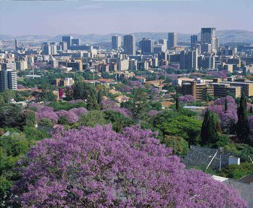
Government Type
Republic
Capital
Pretoria - Administrative
Bloemfontein – Judicial
Cape Town - Legislative
Literacy
Low levels

Slide 10
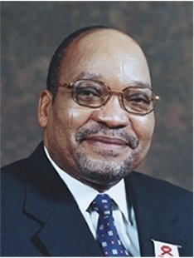
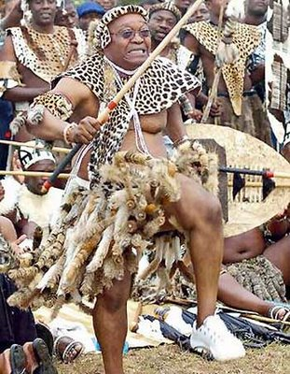
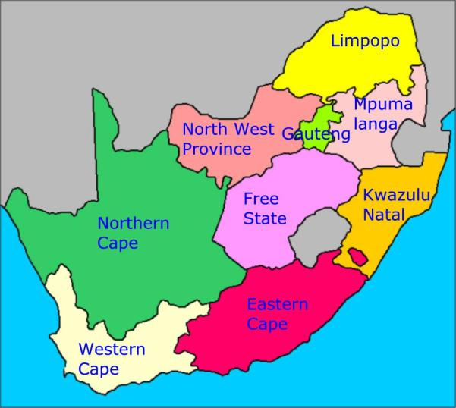
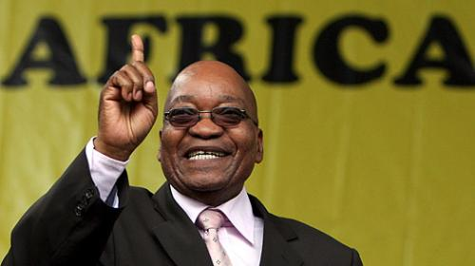
Administrative Divisions
President
President Jacob Zuma
9 provinces
Eastern Cape
Free State
Gauteng
KwaZulu-Natal
Limpopo
Mpumalanga
Northern Cape
North-West
Western Cape

Slide 11


Ethnicity & Religion
Ethnic Groups (2001 census)
Black African 79%
White 9.6%
Colored 8.9%
Indian/Asian 2.5%
Religions
Zion Christian 11.1%
Pentecostal/Charismatic 8.2%
Catholic 7.1%
Methodist 6.8%
Dutch Reformed 6.7%
Anglican 3.8%
Muslim 1.5%
Other Christian 36%

Slide 12
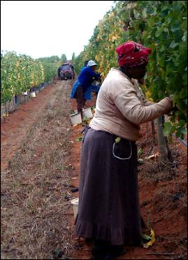
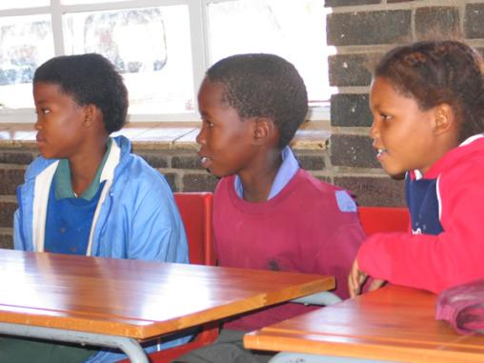
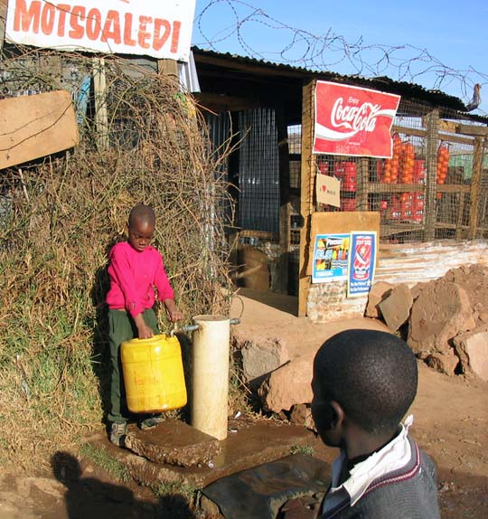
Median Age
24.3 years
Population
Growth Rate
0.46%
Life expectancy at birth
42.45 years
HIV/AIDS – Adult
Prevalence Rate
21.5%

Slide 13
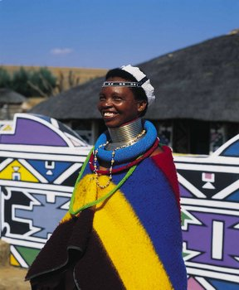
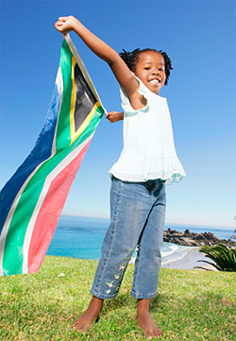
Population
48,687,000
Lower life expectancy
Lower population and growth rates
High infant mortality and death rates
Excess mortality due to HIV/Aids

Slide 14


Slide 15
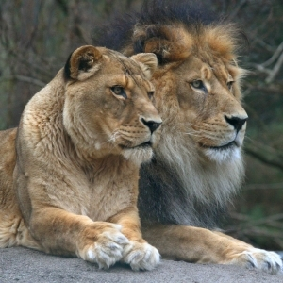
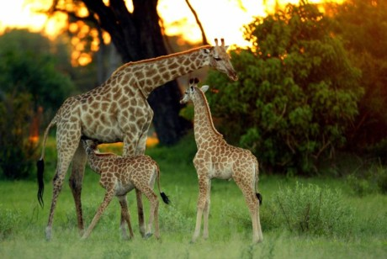
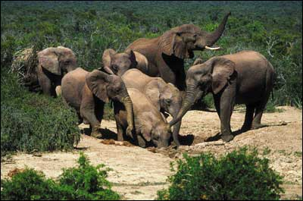

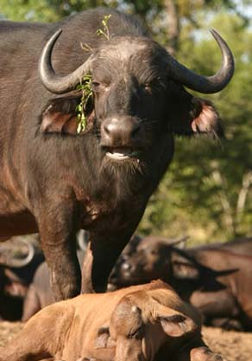
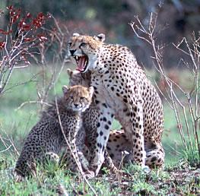
Wildlife
The Big Five
Blue wildebeest, kudus, impalas, hyenas, hippopotamus, and giraffes.
Kruger National Park
Mala Mala Reserve as well as in the far north in the Waterberg Biosphere.
Addo Elephant National Park

Slide 16
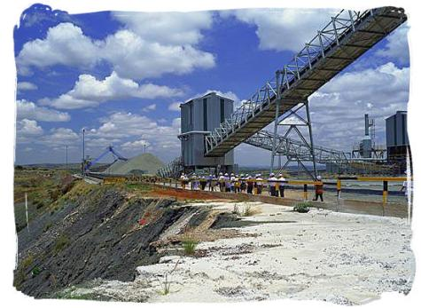
Environment – current issues
Lack of important arterial rivers or lakes requires extensive water conservation and control measures
Growth in water usage outpacing supply
Pollution of rivers from agricultural runoff and urban discharge
Air pollution resulting in acid rain
Soil erosion
Desertification

Slide 17
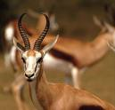
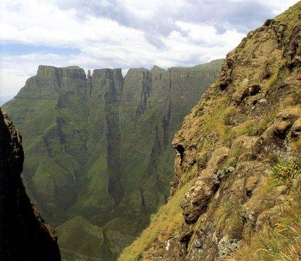
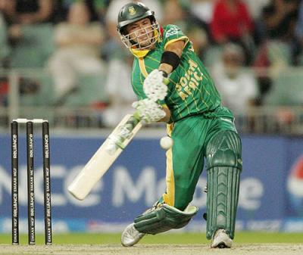
South African Economy
Largest in Africa
24th largest in the world
One of the most socially, economically and infrastructurally developed country on the continent.

Slide 18
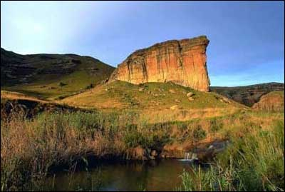
Economy
Golden Gate Highlands National Park
South Africa is a middle-income, emerging market
Abundant supply of natural resources
Developed financial, legal, communications, energy, and transport sectors
A securities/stock exchange that is 17th largest in the world
Modern infrastructure supporting an efficient distribution of goods to major urban centers throughout the region

Slide 19
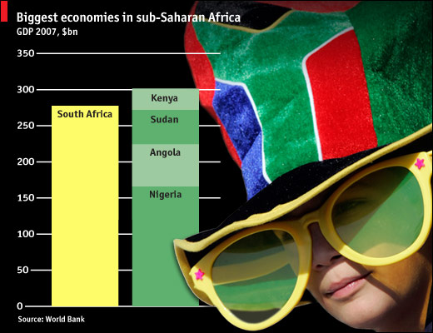
Economy cont.
Growth has been robust
since 2004
South Africa has reaped
the benefits of
macroeconomic stability
Global commodities boom
Unemployment remains high
Outdated infrastructure has constrained growth
2007 electricity crisis

Slide 20
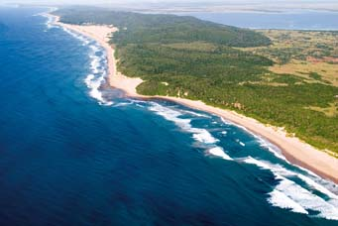
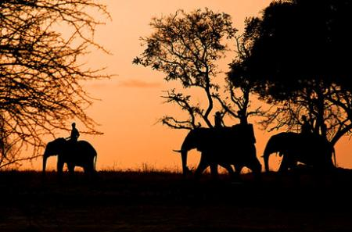
Gross Domestic Product
GDP – per capita
$5 684 (2009) nominal
GDP – composition by sector
Agriculture 0.9%
Industry 20.6%
Services 78.5%
Unemployment rate
24.2% (2009 est.)
Budget
Revenues: $74.92 billion
Expenditures: $86.26 billion (2009 est.)

Slide 21
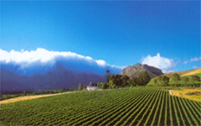
Economic Policy
Fiscally conservative but
pragmatic
Focusing on controlling inflation
Maintaining a budget surplus
Using state-owned enterprises to deliver basic services to low-income areas as a means to increase job growth and household income

Slide 22

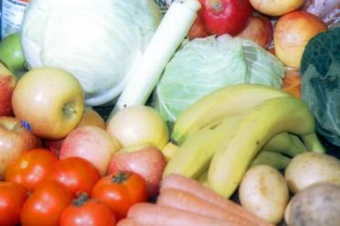

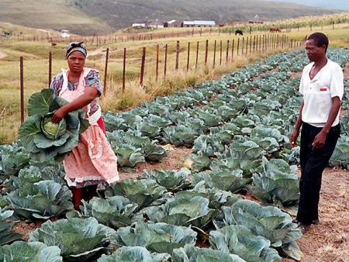
Production
Agriculture products
Corn, wheat, sugarcane, fruits, vegetables; beef, poultry, mutton, wool, dairy products
Industries
Mining – world’s largest producer of platinum, gold, chromium
Automobile assembly
Metalworking
Machinery
Textiles
Iron and steel
Chemicals
Fertilizer
Foodstuffs
Commercial ship repair

Slide 23
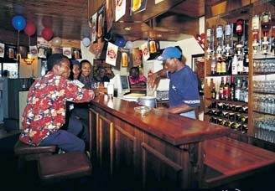
Trade
Exports
$67.93 billion (2009 est.)
Exports – partners (2009)
Japan 11.1%
US 11.1%
UK 6.8%
Germany 8%
Netherlands 5.2%
China 6%
Imports
$70.2 billion (2009)

Slide 24
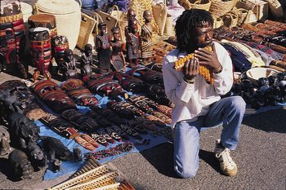
Economic Problems
Economic problems remain from the apartheid era
Poverty
Lack of economic empowerment among the disadvantaged groups
Shortage of public transportation
Income distributed unequally
Highest rate of income inequality in the world

Slide 25
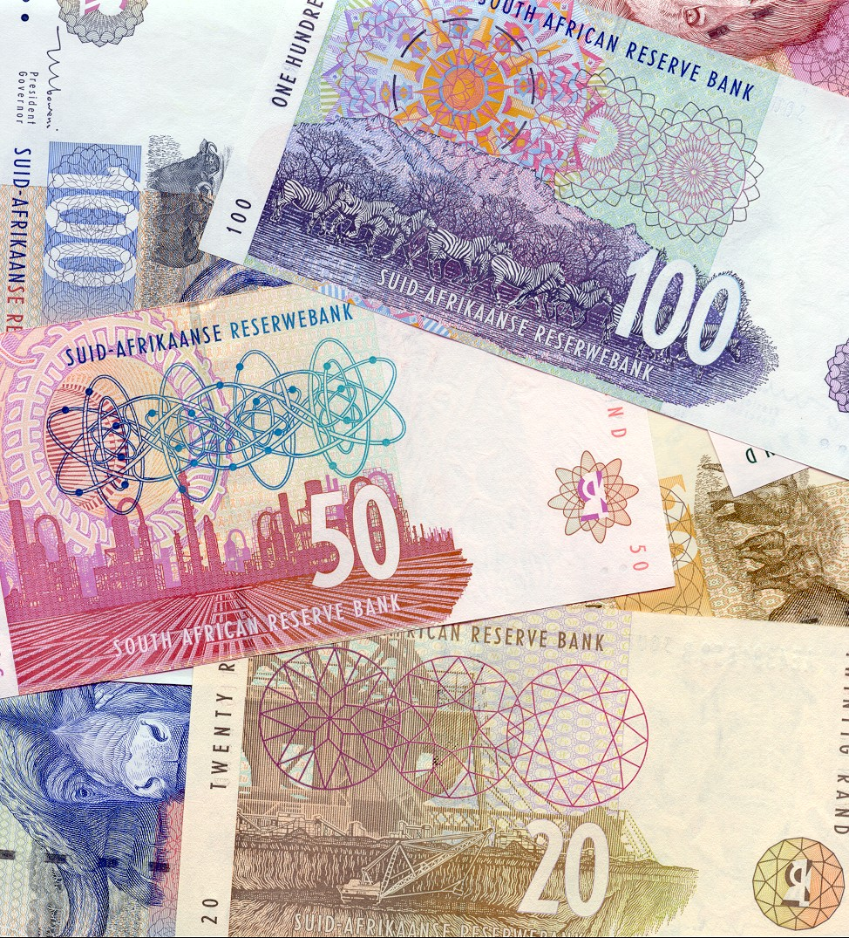
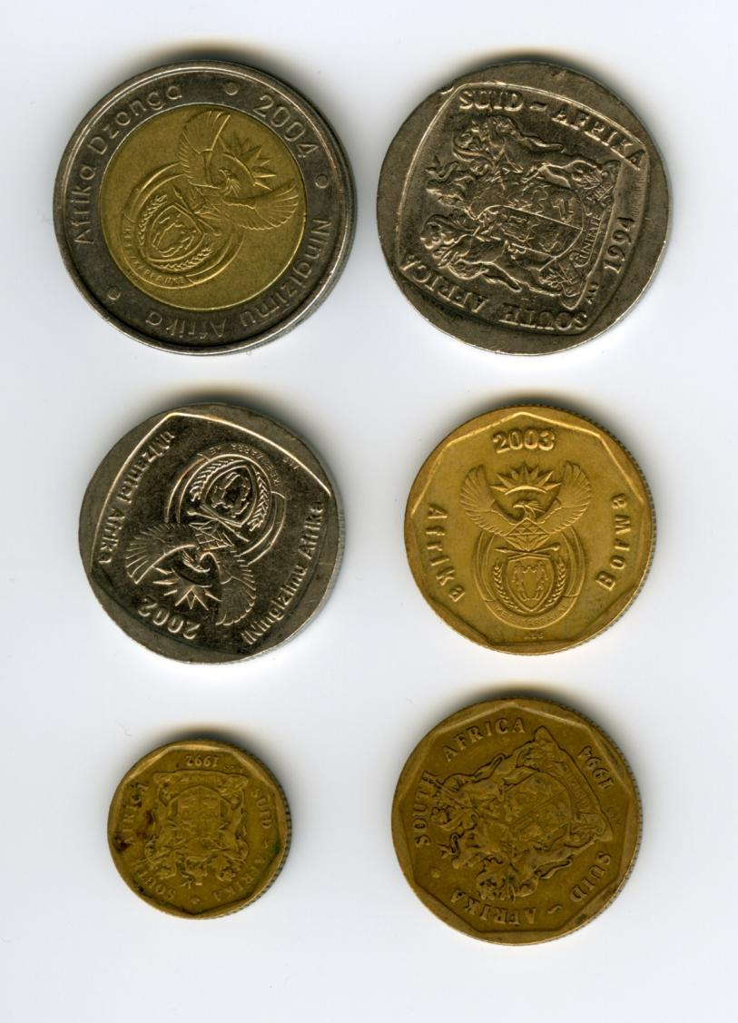

Slide 26
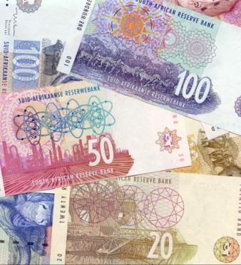
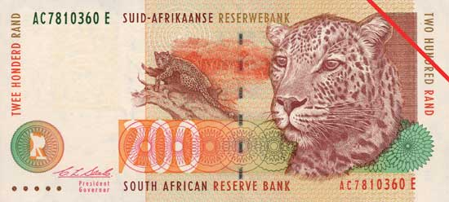
Currency
Currency
Rand (ZAR)
Exchange rates
Rand per US dollar
±7.5 (2010)

Slide 27
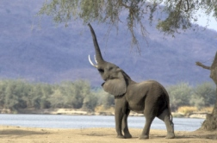
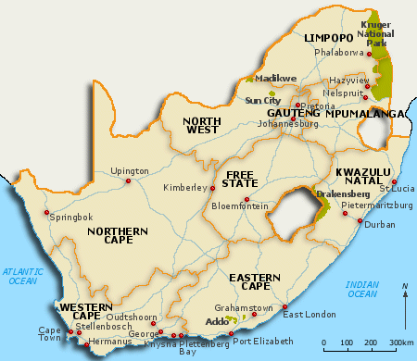
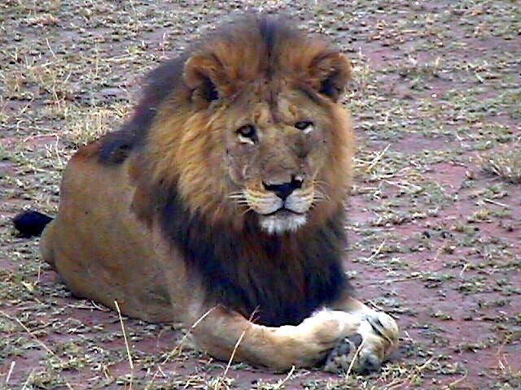
Economic Education in South Africa

Slide 28
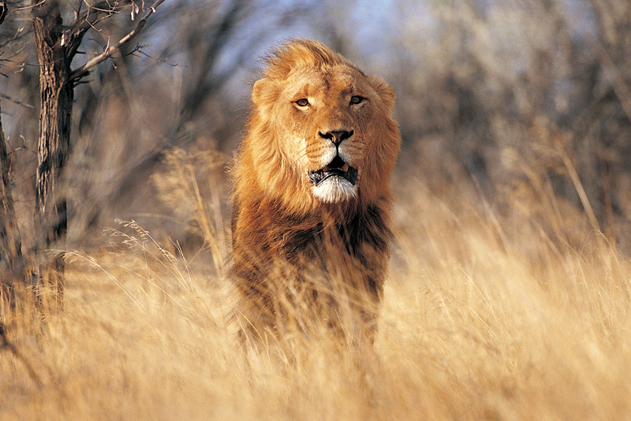

Slide 29

TRANSFORMATION OF EDUCATION
1995
One National Education System
Nated 550
1996
First non-racial provincial examinations administered
1997
South African version of Outcomes-based Education (OBE)
2000
Inclusive education opportunities for all
Curriculum 2005
2002
Review of Curriculum 2005, found low literacy and numeracy levels
Development of Revised National Curriculum Statement
National Curriculum Statement
National Curriculum Statement for FET
2004
Implementation of Revised National Curriculum Statement
2010
Review of National Curriculum Statement

Slide 30
EDUCATION STRUCTURE
12 million learners
366 000 teachers
28 000 schools
22 000
6 000
Primary Schools
High Schools
Grade 1 to 7
Grade 8 to 12
390 special needs schools
1 000 registered private schools

Slide 31
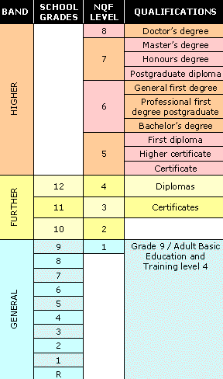
EDUCATION STRUCTURE
Universities, Universities of Technology, other academic institutions
Not compulsory
compulsory
Not compulsory

Slide 32
CURRICULUM
GET
Grades R to 9
FET
Grades 10 to 12
Languages
Mathematics
Natural Sciences
Technology
Social Sciences
Arts and Culture
Life Orientation
Economic and Management Sciences
Fundamental | Language 1 Language 2 Mathematics or Mathematics Literacy Life Orientation
Core and electives | Arts and Culture
 | Business, Commerce, Management Studies and Services
 | Manufacturing, Engineering and Technology
 | Human and Social Studies and Languages
 | Physical, Mathematical, Computer, Life and Agricultural Sciences
Economic and Management Sciences
Business Studies,
Economics,
Hospitality Studies,
Tourism,
Consumer Studies

Slide 33
EDUCATION OBSTACLES
1
Weak school management and leadership
6
Social ills such as poverty and crime
Poor levels of accountability for performance from education officials and educators
The declining quality in school infrastructure
2
7
Slow rate of response and support from the education department
A legacy of underinvestment in a number of areas in the Western Cape
3
8
Inadequate time and attention paid to reading, writing and counting in the first three grades of school
4
The pressure posed by inward migration to the Western Cape
9
Inadequate quality textbooks and other learning materials
The low morale of teachers
5
10

Slide 34
EDUCATION PRIORITIES
1
Literacy and numeracy
6
Poverty and crime
2
Accountability
7
School maintenance
3
Faster response times and support
8
School management and leadership
4
Teacher morale
9
Migration and new schools
Quality texts and materials
Redress
5
10

Slide 35
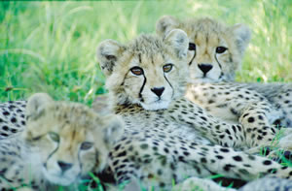
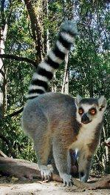
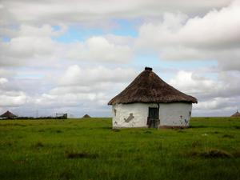







King Protea
Transvaal Stone Plant

Slide 36


PARTNERSHIPS
2004 as an outgrowth of an ongoing relationship between the University of Minnesota and the University of the Free State

Slide 37


PLANS AHEAD
CEE
Train the Trainers 2010/20111
Train the Writers 2010/2011
SAFEFE
ABSA EMS Olympiad – Grades 7-9
Economic Essay Competition-Grade 10
Content Training Educators Grades 10 – 12
Alumni Conference

Slide 38


Economic Development-
Heifer Approach
Development of people in participatory manner
Leads to individual and community ownership
Sustainable in the long term
60 years experience in community development
120 countries

Slide 39

Heifer Model Development
Participatory Rural Appraisal process
Define current situation – looking for positive unexploited potential
Envision the future in 3- 5 years
Ex included: reduce child malnutrition; improve agricultural production for sufficient food; generate income for school, food, electricity;
Community members plan the project
Develop strategies such as type of animals
Participants are trained: husbandry, bookkeeping, nutrition, leadership
Ongoing monitoring and evaluation

Slide 40


More Information
To learn more about South Africa try these movies
Cry the Beloved Country
Beat the Drum

Slide 41
Questions

