Slide 1
GETTING SET UP
Funded by Maritime Transportation Research and Education Center

Slide 2
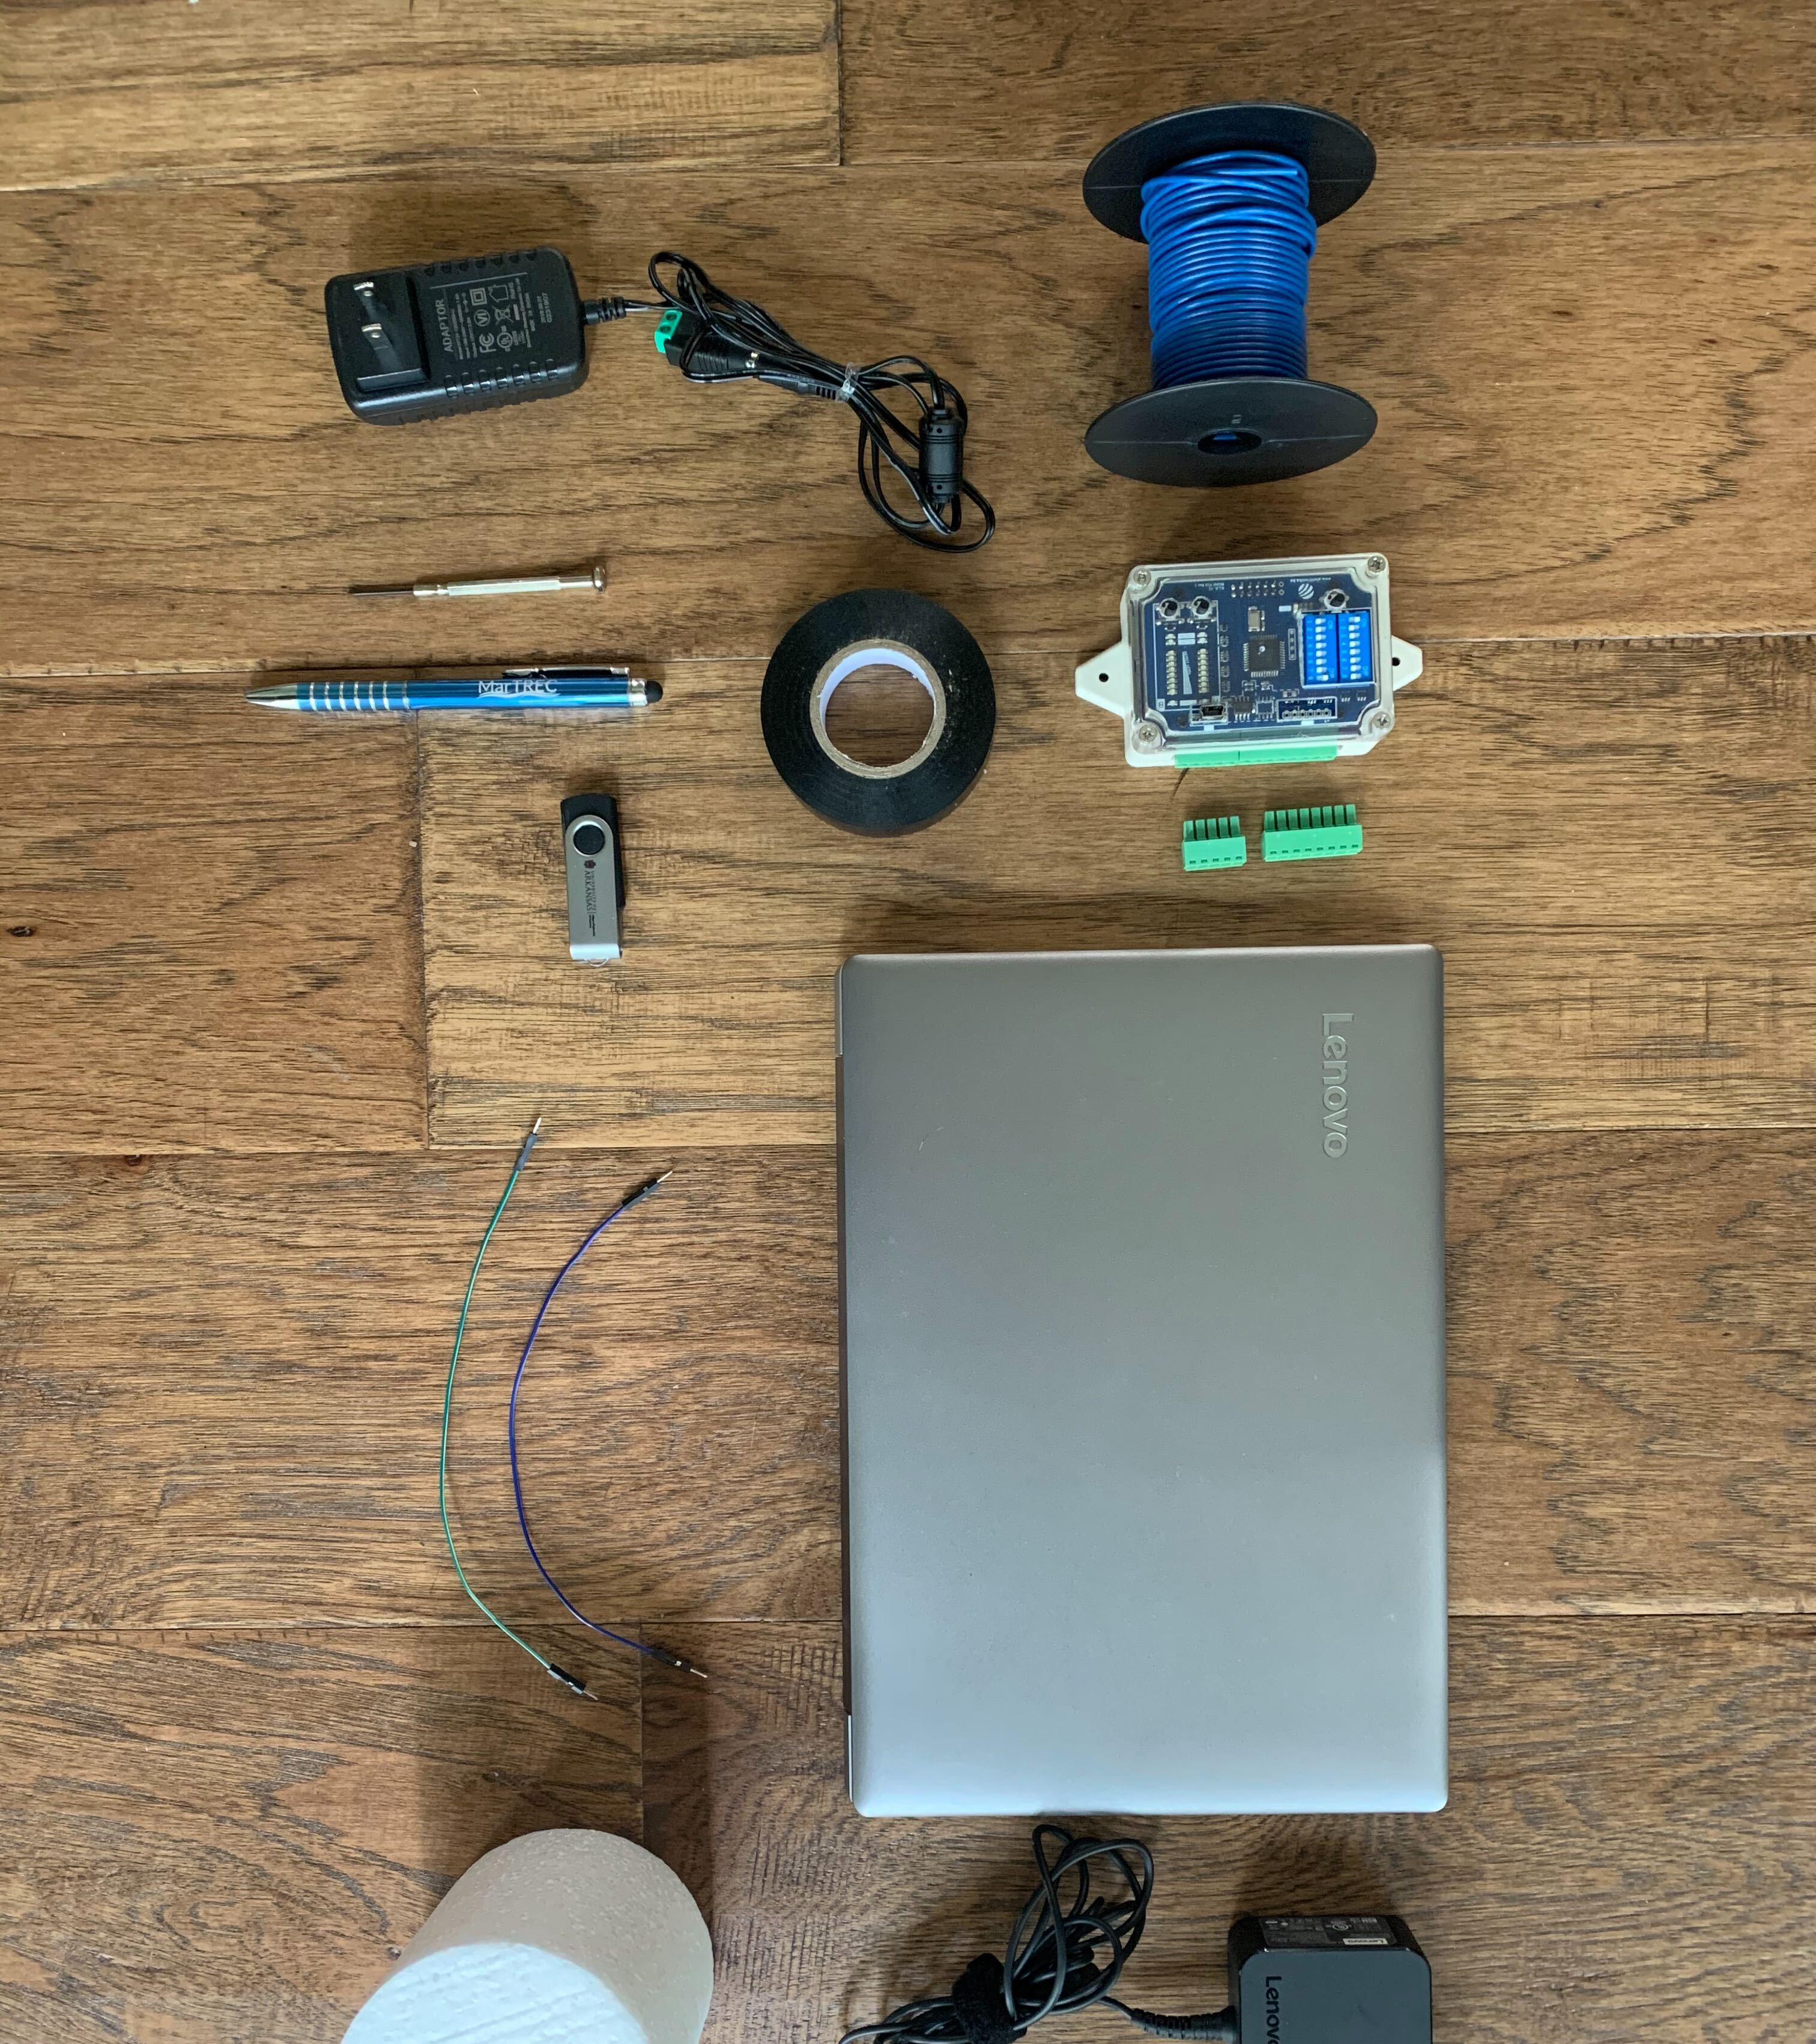
What’s in the kit?
Laptop
Inductive Loop
Detector Card
Toy Truck
Copper Wire
Screwdriver
Electrical Tape
Jumper Wires
AC Adapter
Electrical Converter
Software

Slide 3
OVERVIEW
WHAT ARE WE BUILDING?
This lesson plan guides the group through constructing a miniature inductive loop that is hooked up to a detector card and laptop. The software on the laptop generates graphs based on metal detection from various truck axles and configurations.
The photo to the left gives an idea of what it will look like after set-up.

Slide 4
STEP 1
Create the inductive loop by looping the copper wire 13 times with approximately a 12-inch diameter, being sure to leave 1-2 feet of copper wire as “tails” on each end
Use wire cutters to strip the casing off each tail end, exposing the copper wire
Twist the two “tails” together and secure the entire system with electrical tape
12 inches
Exposed ends
1-2 feet twisted tails

Slide 5
STEP 2
Identify the detector card and 5-port electrical adapter
Loosen the two left-most screws on Port A using the precision screwdriver
Insert exposed copper wire ends from inductive loop and tighten screws down until secure
Detector Card
5-Port Adapter
Precision Screwdriver

Slide 6
STEP 3
Identify the AC Power Adapter and Converter
Attach the converter to the end of the AC Power Adapter
Loosen both screws on the converter using the precision screwdriver
Place the metal end of a jumper wire in each of the ports that were loosened, then secure using precision screwdriver
Plug plastic ends of jumper wires into the two left-most slots on Port B of the inductive sensor
Supply power to AC Adapter through outlet
AC Power Adapter
Jumper Wires
Converter

Slide 7
STEP 4
Connect laptop to its charger and supply the charger with power through an outlet
Plug the USB/micro-USB cable into the computer (USB port) and the top of detector card (micro-USB port)
Charger
USB Port
Note:
Power is now supplied to both the AC Adapter and the laptop charger
Micro-USB Port

Slide 8
STEP 5
Power the laptop on and sign in using the provided password
Open the software file on the Desktop titled “DLDConfig1v1” that has a little green icon as shown in the picture
Green Icon

Slide 9
STEP 6
Connect/Disconnect Button
On the navigation pane on the left-hand side of the screen, select “Operating mode”
Click the “Connect/Disconnect” button at the top of the window and ensure it is highlighted green, signifying it has connected to the inductive sensor
Under the dropdown menu following “Operating Mode” in the main window, select “Single Channel (A)”

Slide 10
STEP 7
On the navigation pane, select “Sampling speed”
Ensure the sampling speed sliding scale at the top is set for 40000/50000

Slide 11
STEP 8
On the navigation pane, select “Event viewer”
Click on the button “Event logging on/off” and make sure it reads “Logging is currently: On” just to the right of the button
This screen should generate an event list of what type of detection has occurred

Slide 12
STEP 9
On the navigation pane, select “Signal analysis”
Click on the button “Signal analysis on/off” and ensure it reads that “Signal analysis is currently: On” just to the right of the button
This screen should generate a graph when the loop detects metal

Slide 13
GIVE IT A TRY
Use a cell phone or one of the toy trucks to ensure the loop is communicating with the software and a graph is being generated

Slide 14
SET UP IS NOW COMPLETE

