Slide 1
THE CASE OF THE
BLUEBERRY FARM

Slide 2
Meet the Diaz Family
160-acre blueberry farm in Fayetteville, Arkansas
Locally owned and operated for 60 years, started by their great-grandparents
Need dry fertilizer for sustainable and consistent crop
This fertilizer comes from ports off the Arkansas River
Grandma and Grandpa Diaz
1980

Slide 4
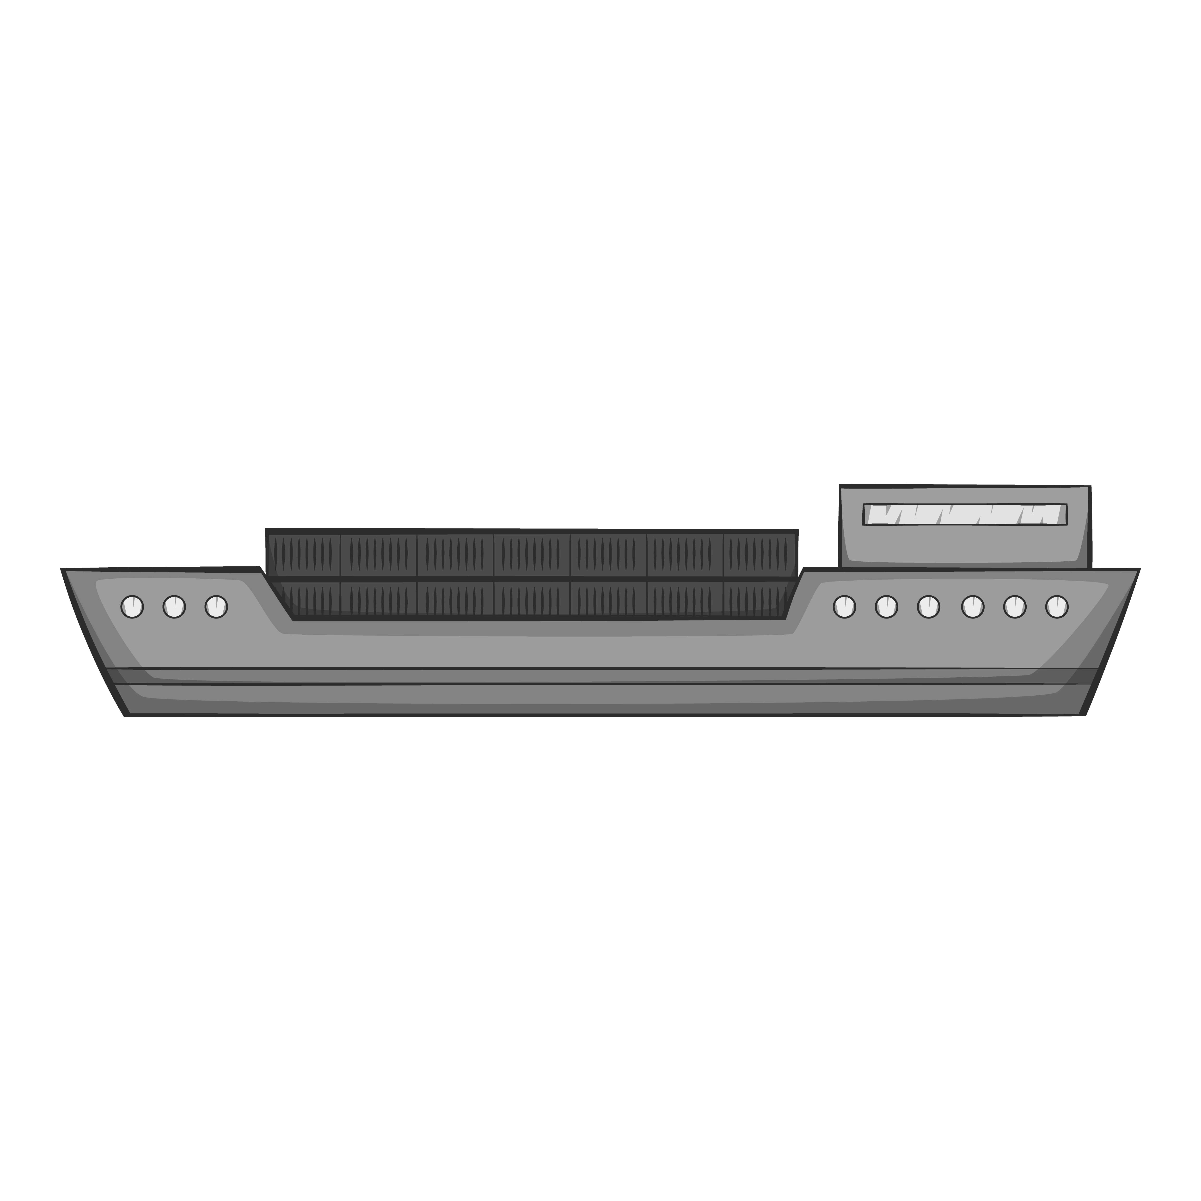
From Little Rock to Van Buren
The Great State of
The dry fertilizer is produced, bundled, and loaded on a barge
ARKANSAS
Fayetteville, AR
The barge travels up the river from Little Rock until it reaches Van Buren
Van Buren, AR
Little Rock, AR
The fertilizer is then loaded onto tractor-trailer trucks
These trucks take I-49 north until they reach Fayetteville to deliver the fertilizer to the blueberry farm

Slide 5
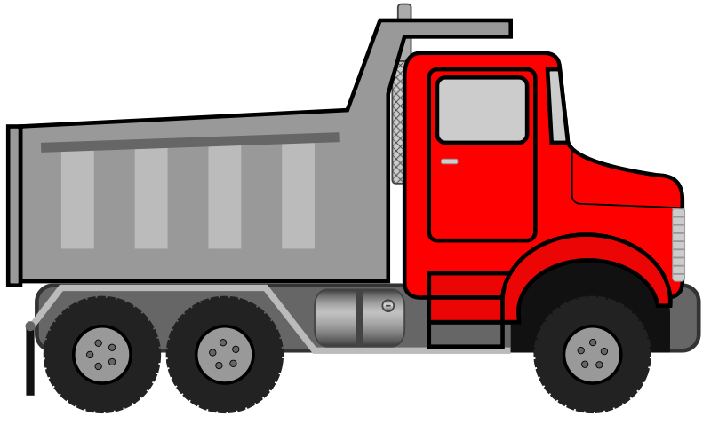
Sand for Sandboxes
Another major commodity that comes out of the Van Buren Port is sand
This sand is used to fill the sandboxes in all the Northwest Arkansas parks
The sand is transported by a different style of truck – a dump truck
Unique truck characteristics helps us determine how many are carrying fertilizer and how many are carrying sand
DRY FERTILIZER
SAND
Different Cab Styles
Different Axle Spacing

Slide 6
Let’s Compare
DRY FERTILIZER
SAND
No bumps in the graph
Bumps in the graph
Larger graph
Smaller graph

Slide 7
BUDGET: $30 MILLION

Slide 8
Investment Options
OPTION #1
OPTION #2
Widen Highway 71B to four lanes in each direction
$30 million
This is the route used by tractor-trailers carrying sand
Thicken the pavement on Interstate-49
$30 million
This is the route used by tractor-trailers carrying dry fertilizer

Slide 9
HOW DO WE JUSTIFY INVESTMENT DECISIONS?
DATA

Slide 10
Your Turn!
This is where specific instructions on opening their dataset will go. This dataset will help the students prove that thickening the pavement on Interstate-49 is a better investment based solely on truck counts.
Open-source code will be used to count the trucks based on body style according to the graphs on slide 6.

Slide 11
LOCAL IMPACT
Everyone and everything is affected by transportation engineering – on a big scale all the way down to individual blueberry farms.
Next time you might be shipping textbooks to your school or medical supplies to the hospital in town.
Your work as a transportation engineer can make a lasting impact on your community, whether you’re filling sandboxes or saving family farms.

