Slide 1
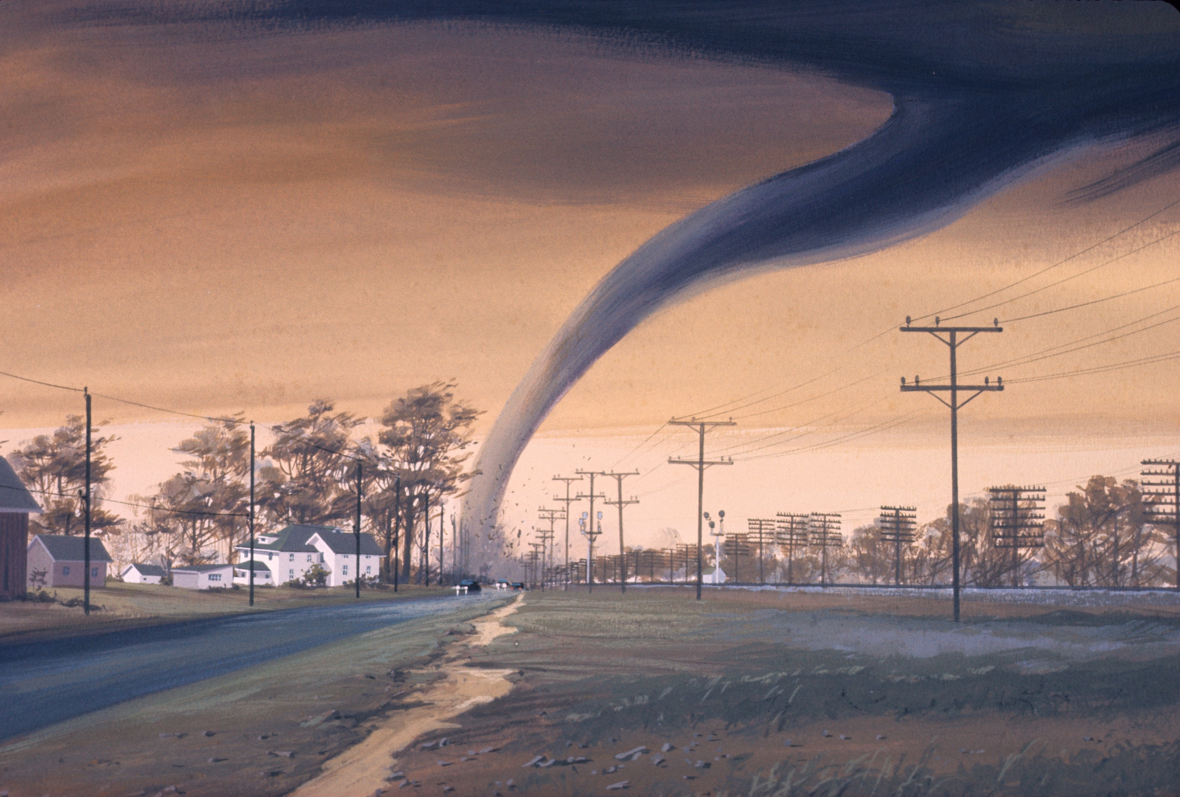
THE CASE OF THE
JONESBORO TORNADO

Slide 2
Meet the Bower Family
John is a lawyer and Alex is a software engineer in town
They have been Jonesboro residents for the last 10 years
Their children, Amelia and Madeline, attend the local public early childhood school
They lost their home in the Spring of 2020 when a violent tornado swept through Jonesboro

Slide 4
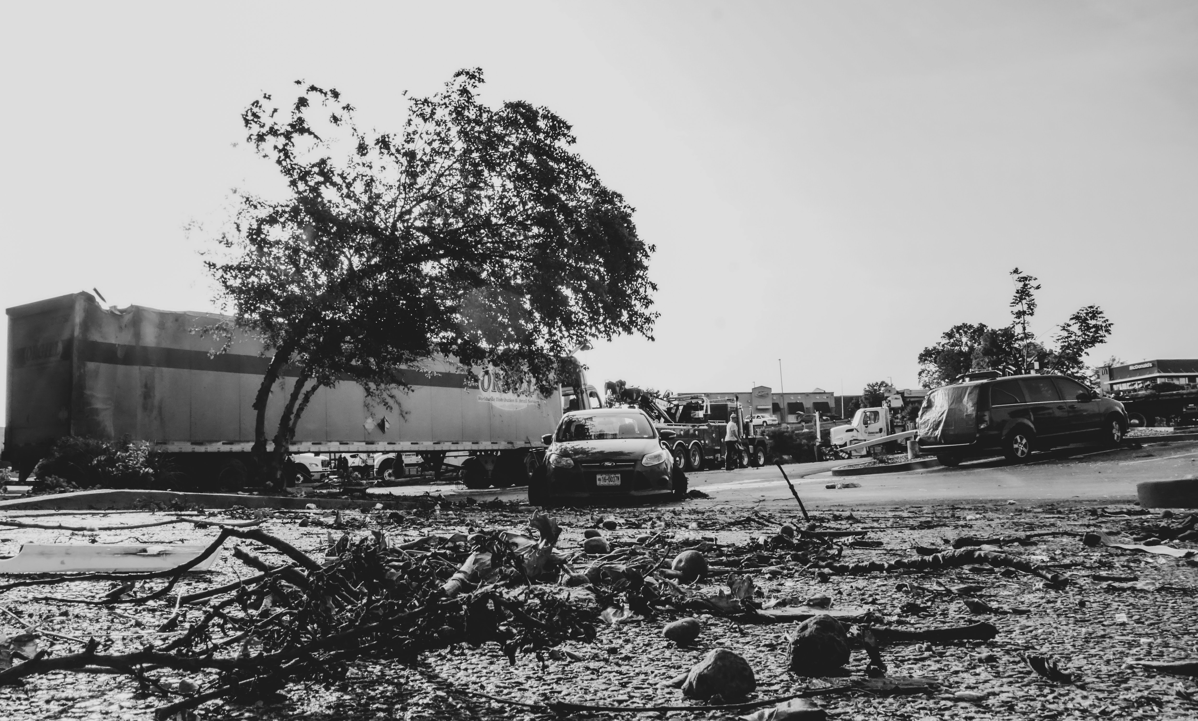
Rebuilding Our Cities
Organizations and volunteers across the nation show up to rescue and rebuild our cities in times of need
However, supplies are still needed
Rebuilding businesses and homes takes a lot of fundamental materials that we don’t always consider when faced with a natural disaster
These materials are things like gravel or sand and are transported through the ports in Arkansas

Slide 5
So how does the gravel and sand get to use when we need it?

Slide 7
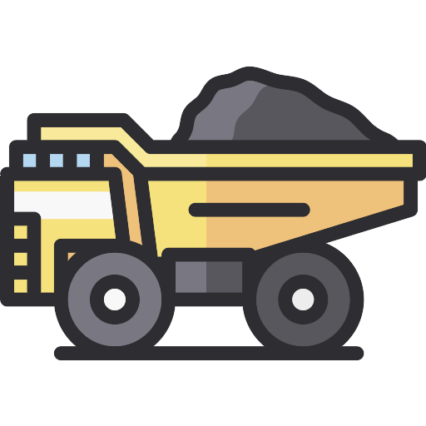
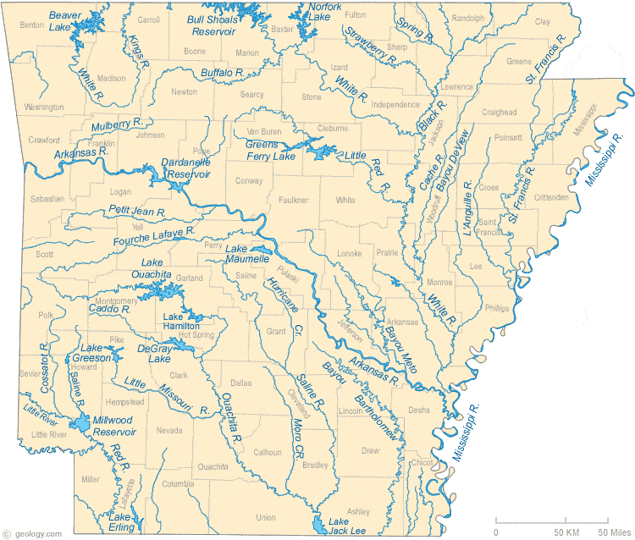
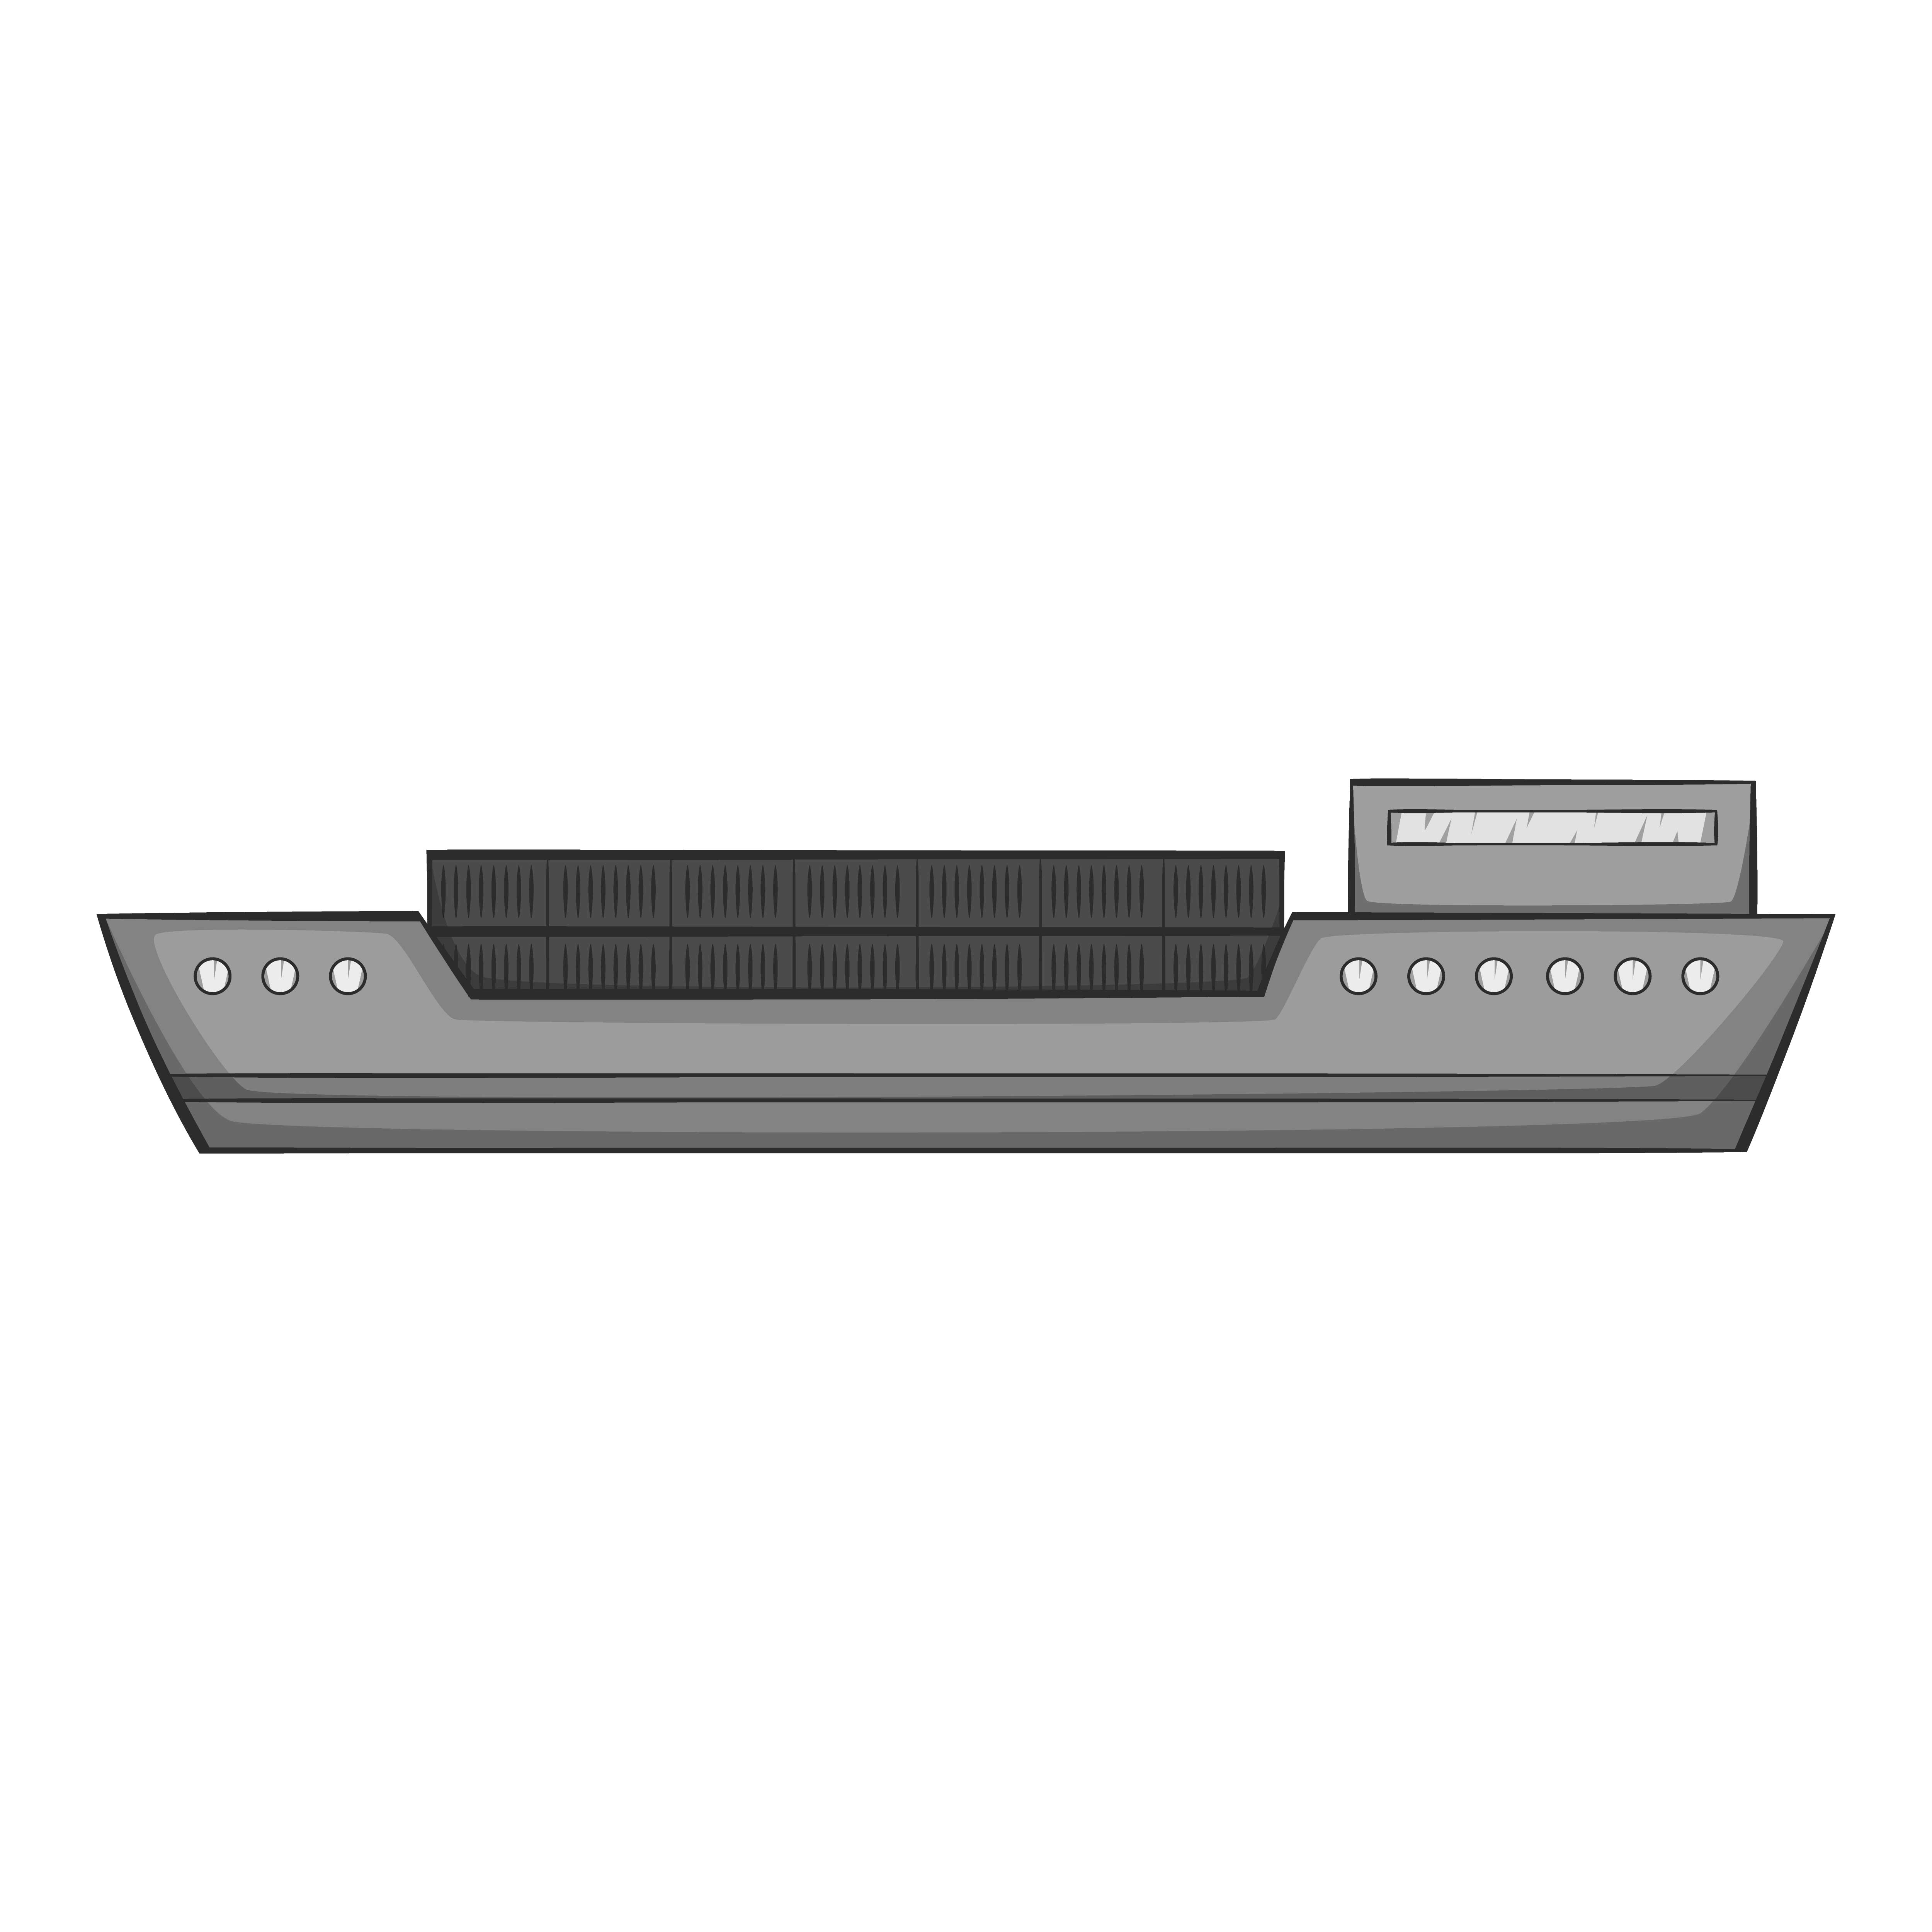
Two Possible Routes
The Great State of
ARKANSAS
The sand and gravel is collected and loaded onto barges at ports
These barges travel to other ports along the continuous waterways
The two closest ports that could service the Jonesboro area are The Port of Little Rock and The Port of Memphis
When deciding between which port should service an area, we must consider the roadway network, railway network, capacity, and other factors relating to the port

Slide 8
What Are The Factors?
While Jonesboro has been recovering for many months, it has been estimated they still need approximately 200 more tons of gravel and 100 more tons of sand to finish rebuilding
This sand and gravel will travel by barge either to the Port of Little Rock or to the Port of Memphis
It is your job today to recommend which port to use so that families like The Bowers might have their homes rebuilt as quickly and efficiently as possible
Today we will be examining a concept called capacity, which refers to how many trucks are present at a port compared to how many the port is able to service at any given time
Comparing the capacities of the Port of Little Rock and the Port of Memphis will help determine which port should be utilized

Slide 9
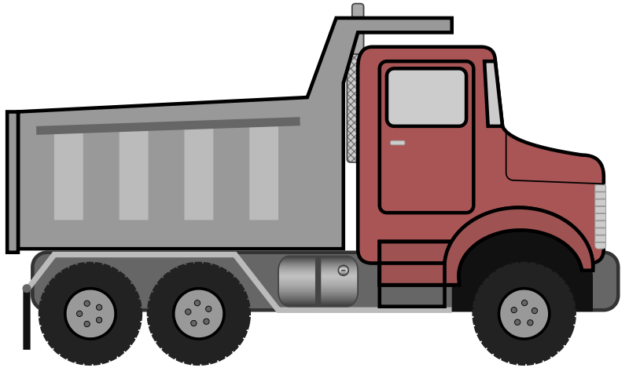
It’s Not Just Servicing Gravel and Sand
Many other commodities are transported through both ports in addition to sand and gravel
We need to be able to identify how many trucks are helping Jonesboro versus how many are transporting other commodities
Sand and gravel are transported by a different style of truck – a dump truck
Unique truck characteristics helps us determine how many are carrying sand and gravel versus how many are carrying other commodities
OTHER COMMODITIES
SAND
Different Cab Styles
Different Axle Spacing

Slide 10
Let’s Compare
OTHER COMMODITIES
SAND
No bumps in the graph
Bumps in the graph
Larger graph
Smaller graph

Slide 11
Two Possible Ports
PORT #1: Little Rock
PORT #2: Memphis
The Port of Little Rock can service 90 trucks per day
Inductive Sensors in driveway
Use the data provided
The Port of Memphis can service 130 trucks per day
Inductive Sensors in driveway
Use the data provided

Slide 12
Your Turn!
This is where specific instructions on opening their dataset will go. This dataset will help the students prove that gravel and sand should be transported through The Port of Little Rock up to Jonesboro due to capacity constraints at The Port of Memphis.
Open-source code will be used to count the trucks based on body style according to the graphs on slide 6.

Slide 13
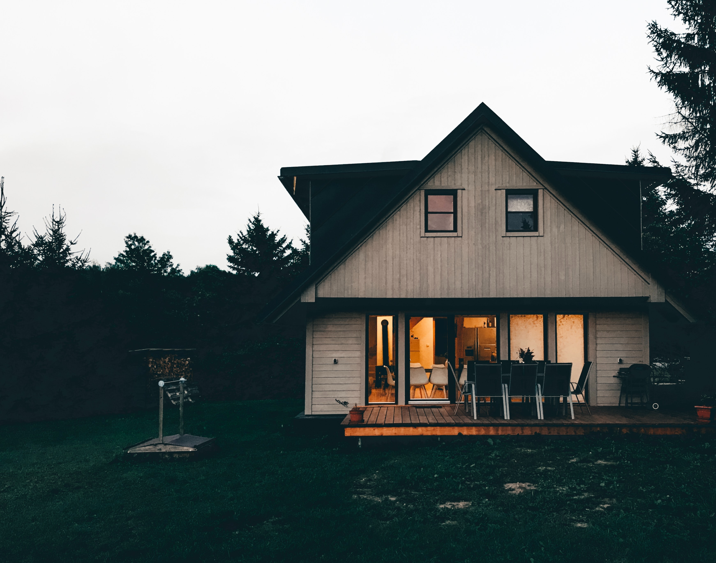
LOCAL IMPACT
Everyone and everything is affected by transportation engineering – on a big scale all the way down to each individual house in your neighborhood.
Next time, you might be shipping textbooks to your school or medical supplies to the hospital in town.
Your work as a transportation engineer can make a lasting impact on your community, whether you’re filling sandboxes or rebuilding your community.

